Slide 1
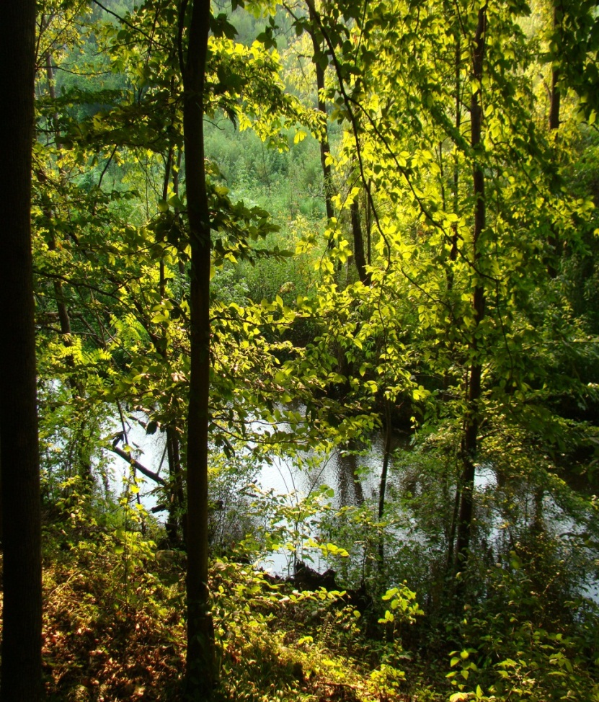
Sinking Creek Restoration Project & Environmental Education Park

Slide 2
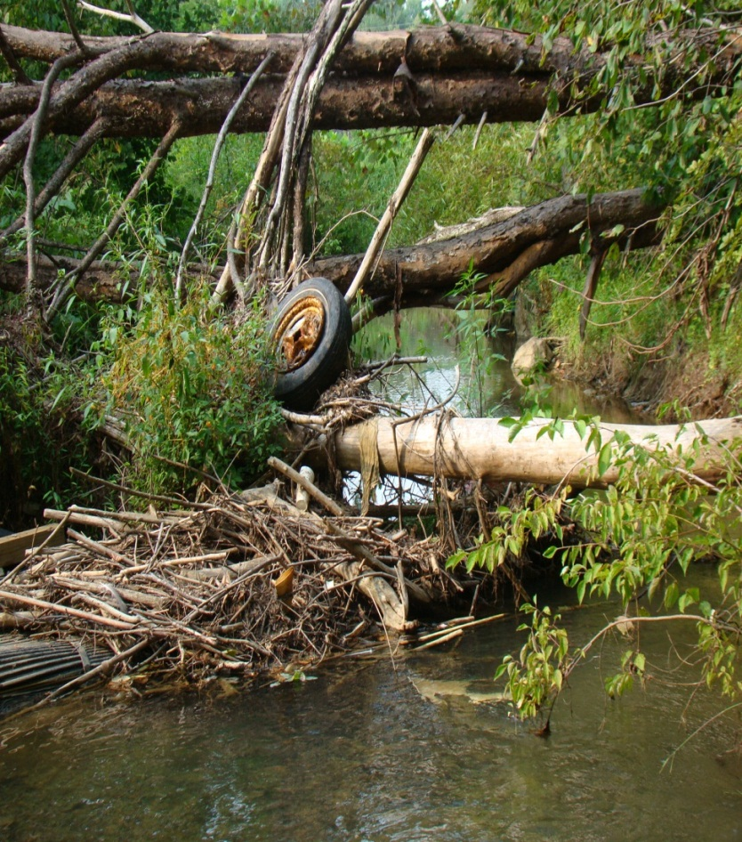
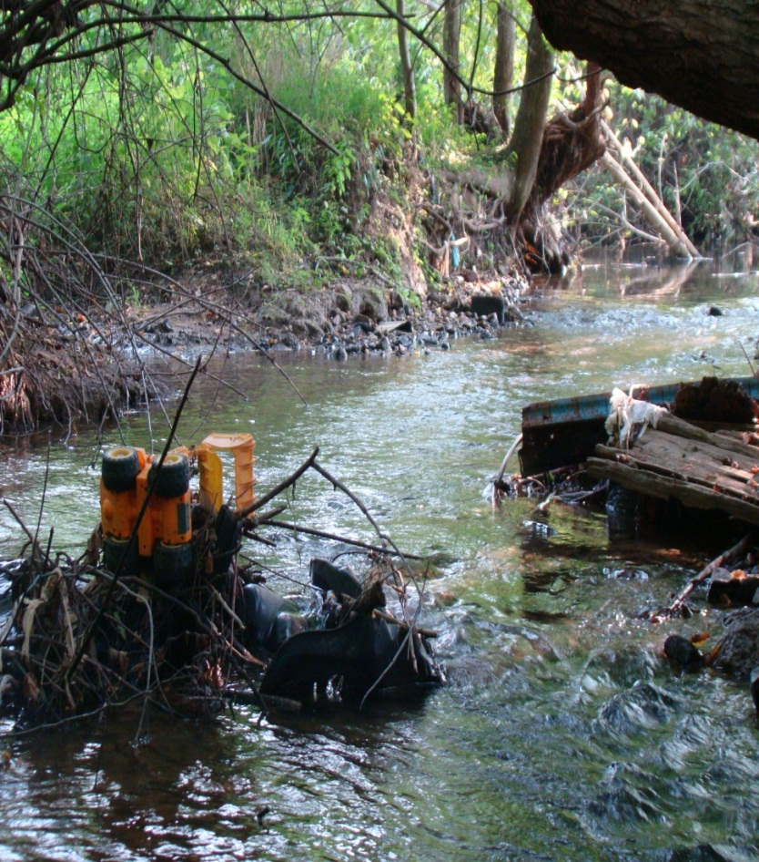

Slide 3
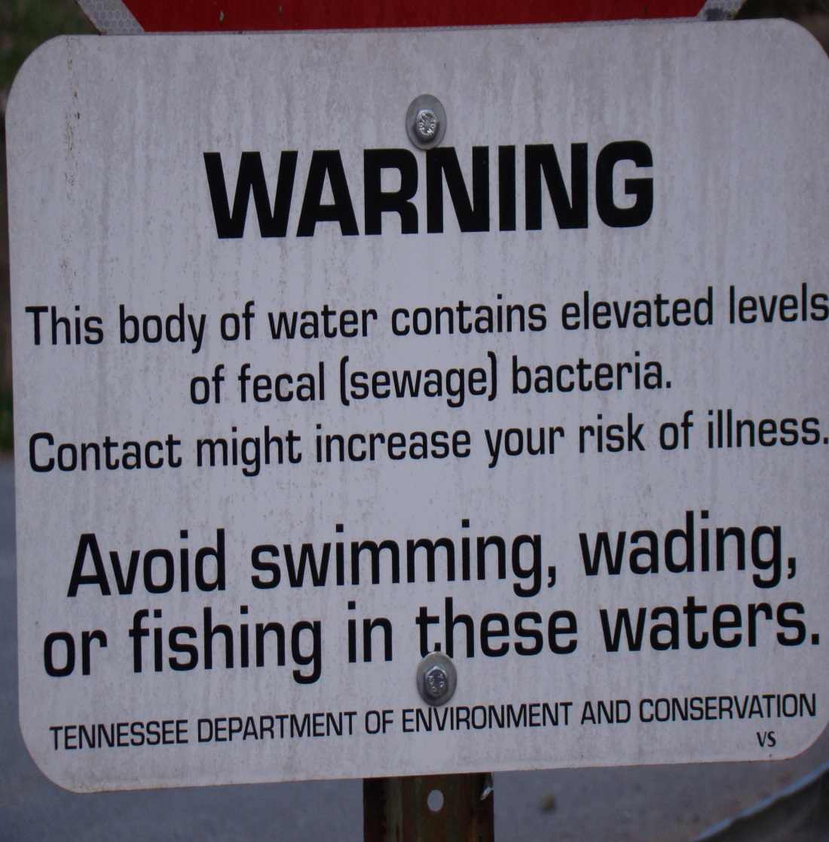
A Community Addressing a Problem
In 2008, Tennessee Dept. of Agriculture awarded the Boone Watershed Partnership with an EPA funded, 319 grant of $300,000 of a total project budget of $517,000 to address nonpoint source pollution (Escherichia coli) in Sinking Creek, a 303(d) listed stream.

Slide 4
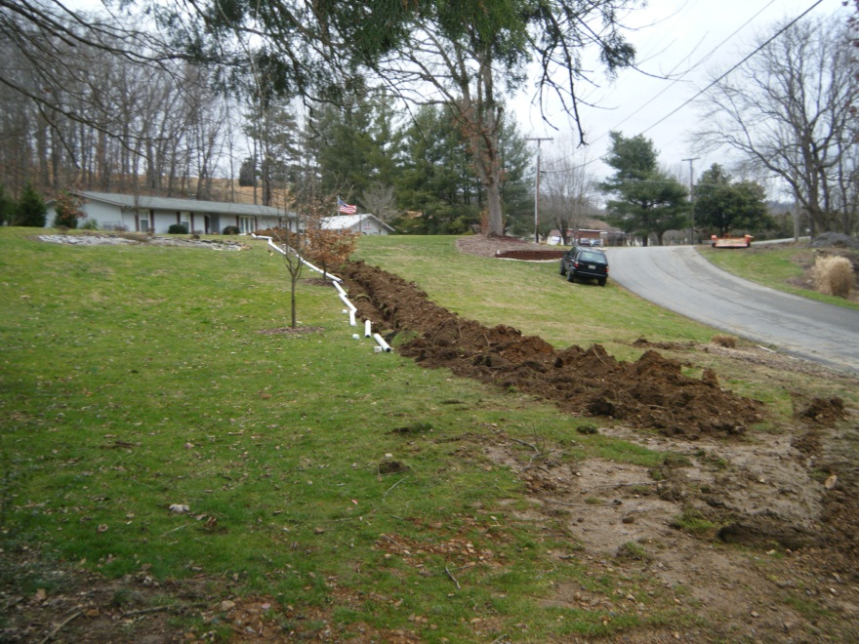
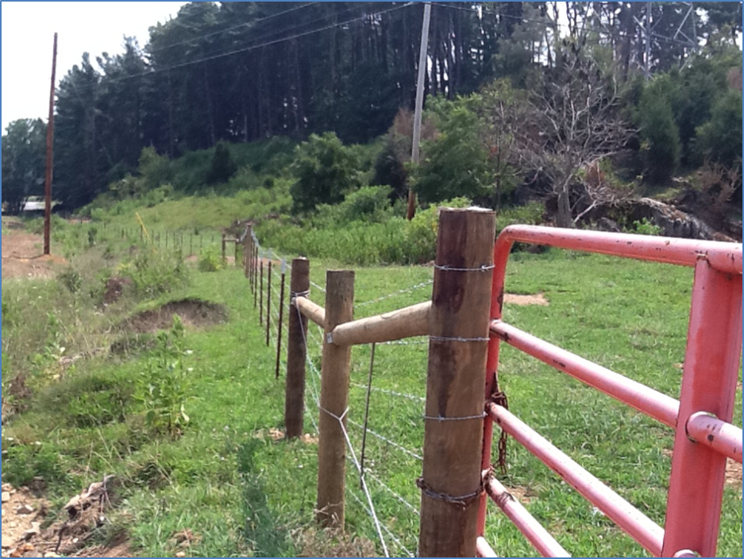
Sinking Creek Restoration
24 sewer hook-ups
5 septic tank/drainfield repairs
1 agricultural project- fencing livestock from creek
2.1 acres wetlands enhancement

Slide 5
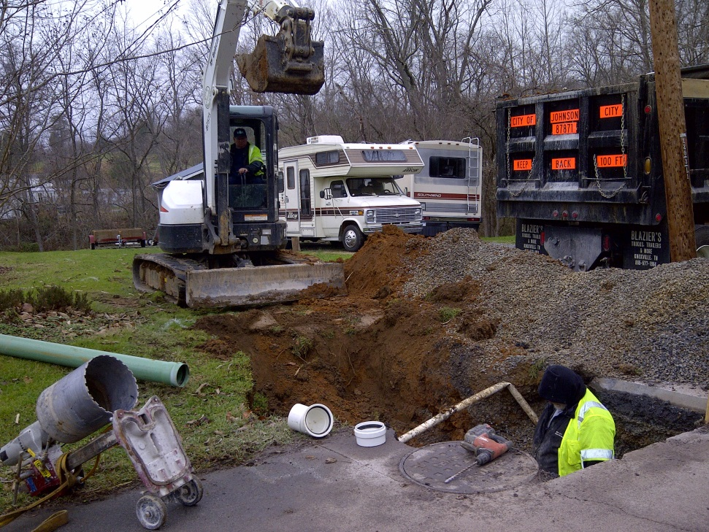
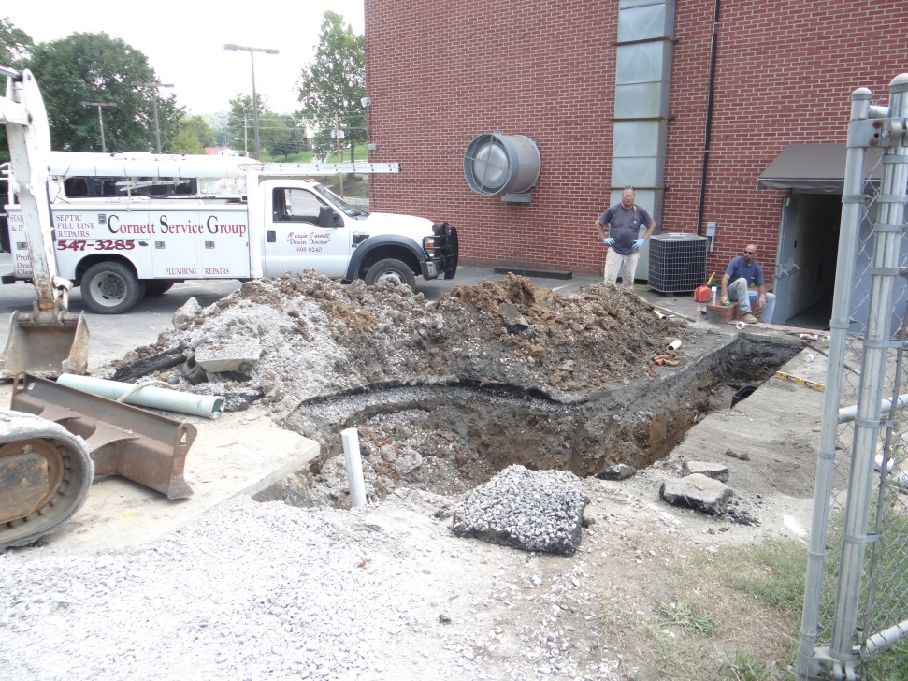
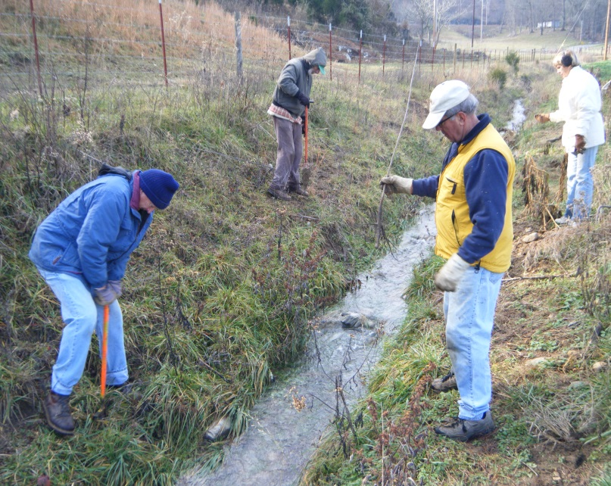
Johnson City Extended Service, Oldest Church in Tennessee Found Sewage Caves, Tipton Haynes Historic Site Fenced Out Cattle & Planted Trees

Slide 6
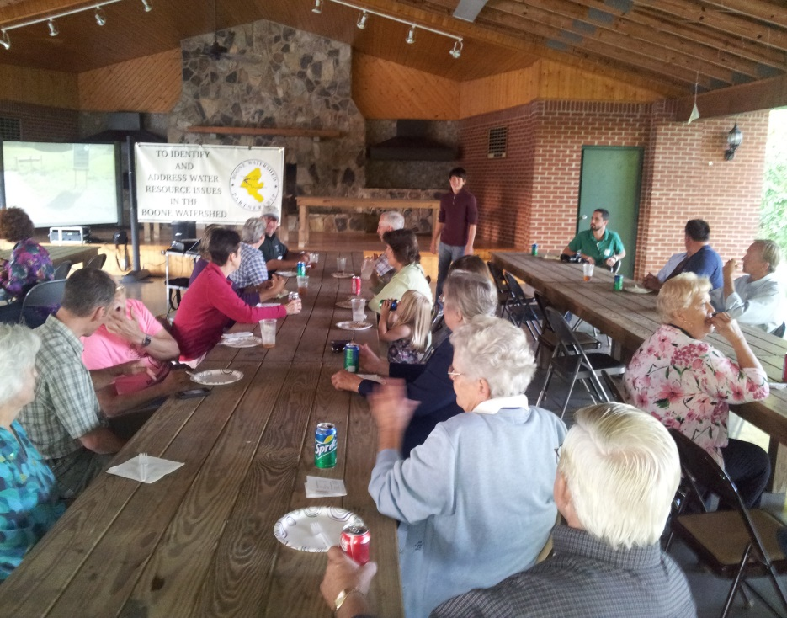
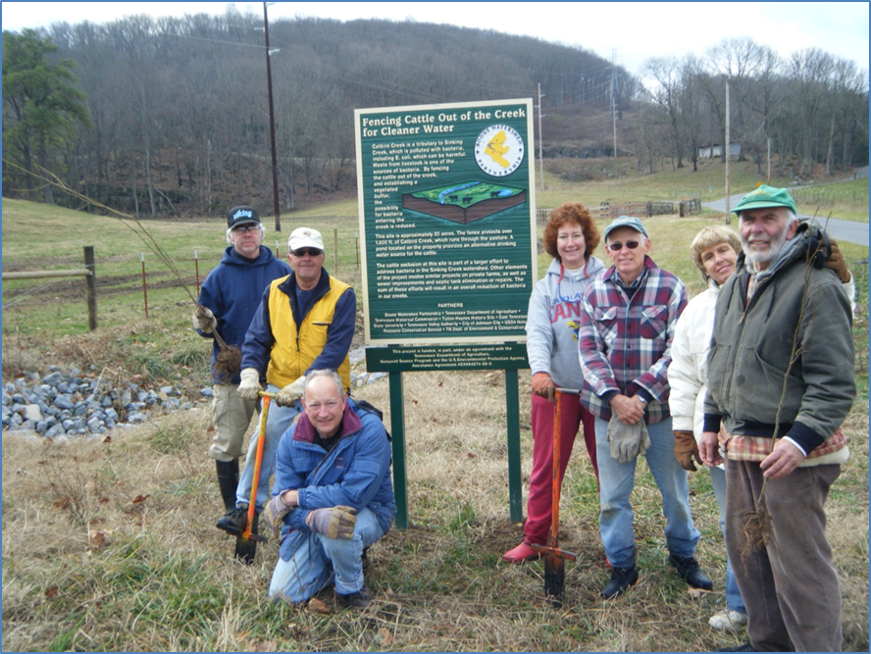
Restoration Project Partners
City of Johnson City
Boone Watershed Partnership
TDA
TVA
TDEC
Volunteers and landowners

Slide 7
Sinking Creek Wetlands
Enhanced wetlands are effective in removing pathogens from water.
An Engineering Study found that the enhancement of the wetlands along Sinking Creek, owned by Johnson City, would improve the water quality of the creek and reduce flooding downstream.

Slide 8
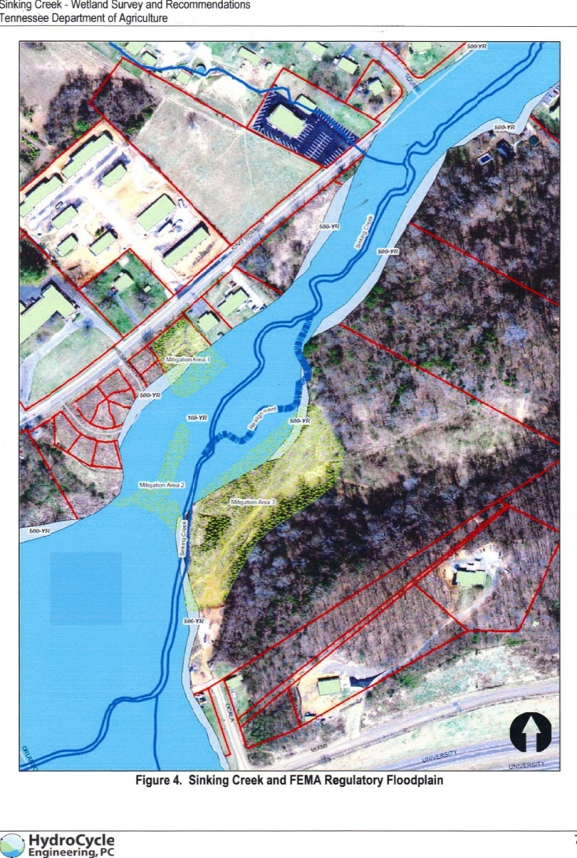
Wetlands Flood Plain
The neighborhood was prone to flooding downstream.
The enhanced wetlands will mitigate flooding in the area.

Slide 9
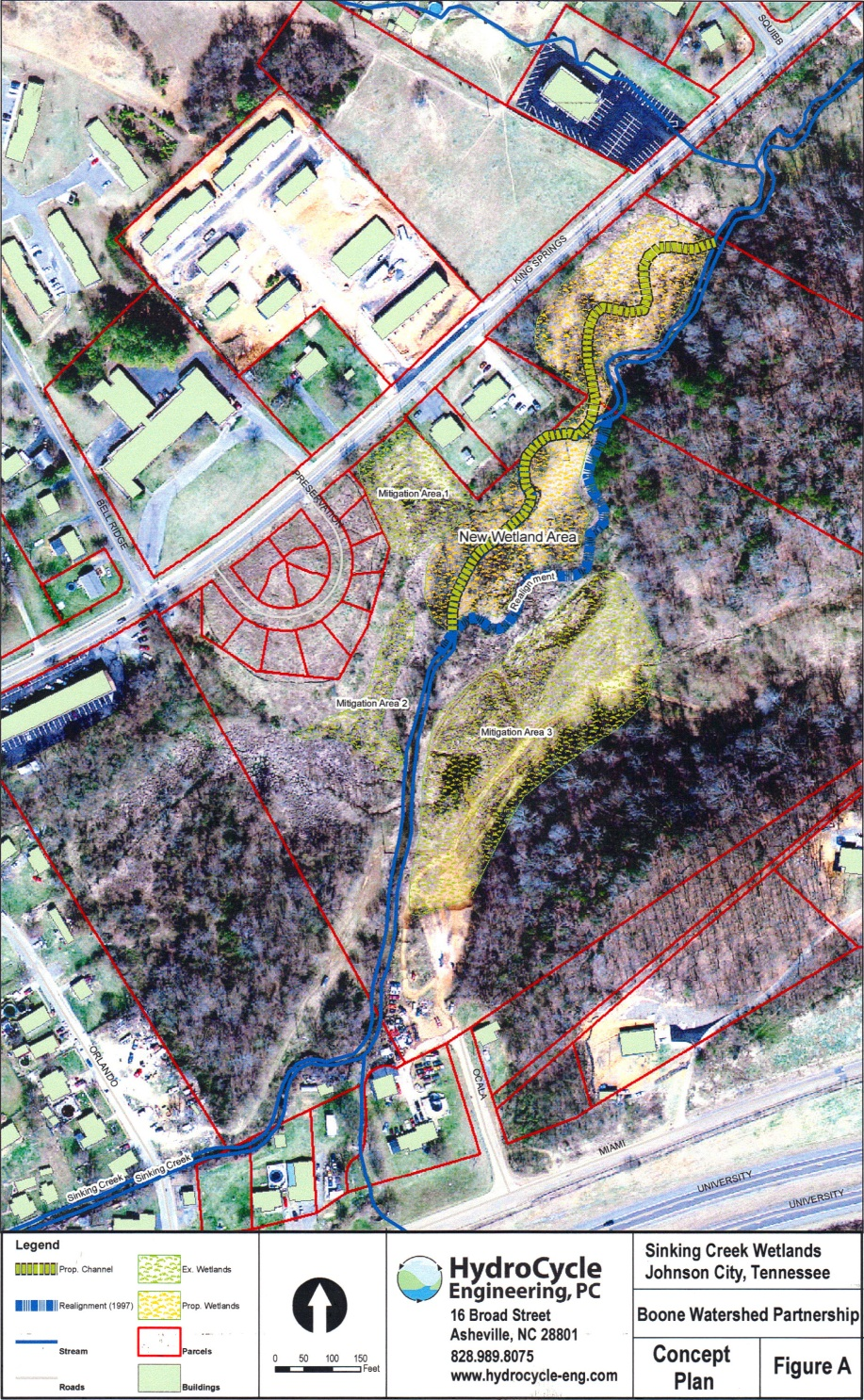
New Wetlands Area
An old streambed was excavated for additional drainage and native plants to enhance existing wetlands by 2.1 acres resulting in over 5 acres of urban wetlands.
The new wetlands will reduce pollutants and pathogens from reaching Sinking Creek.

Slide 10
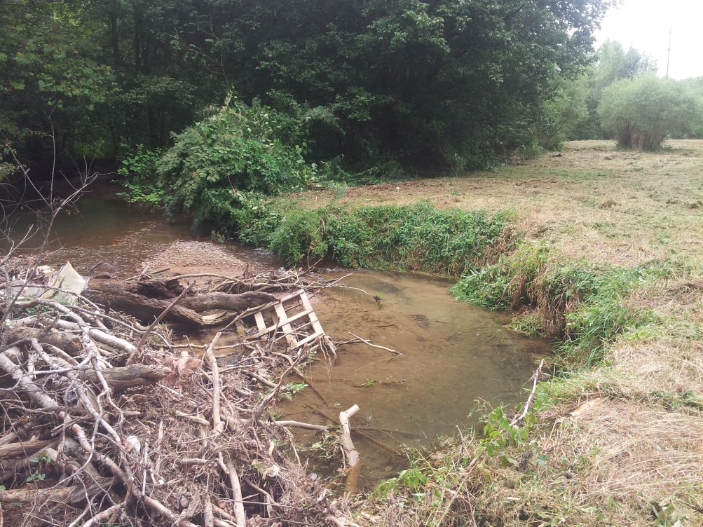
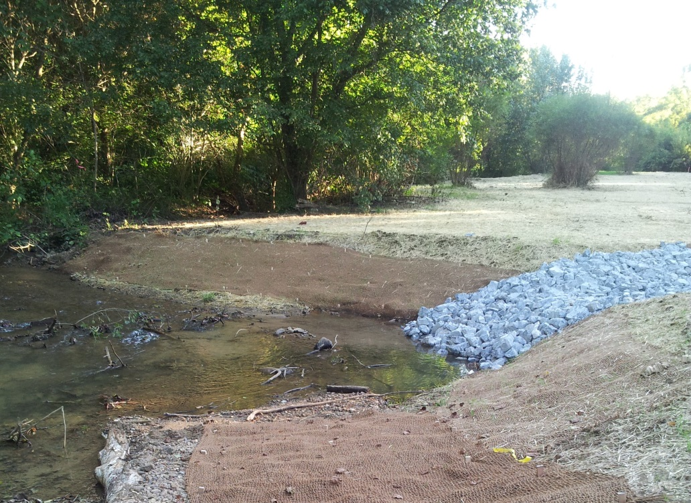
A before and after shot of a restored streambank in the wetlands. A logjam here was causing the streambank to erode. Note the invasive shrub, Japanese knotweed, has been removed.

Slide 11
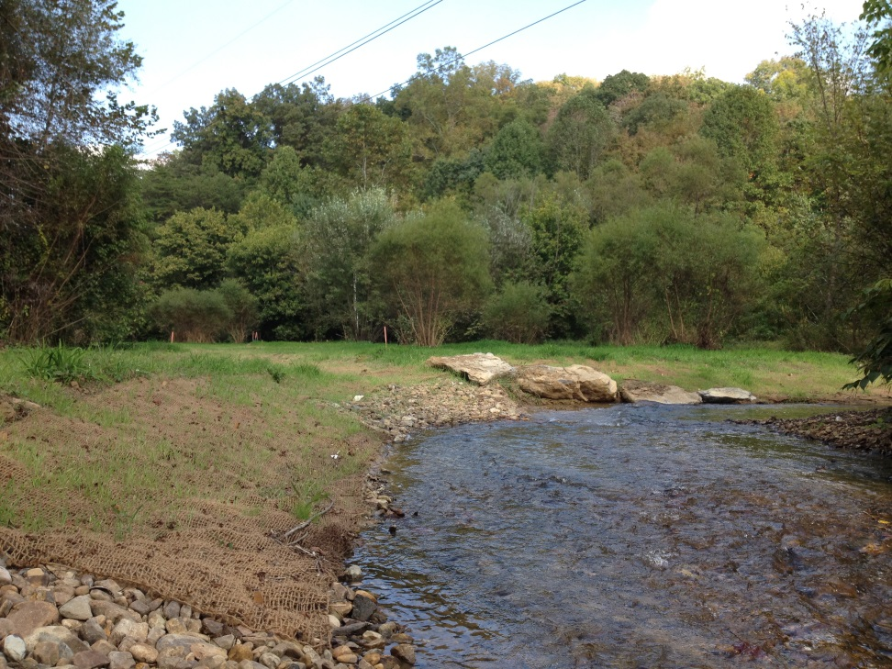
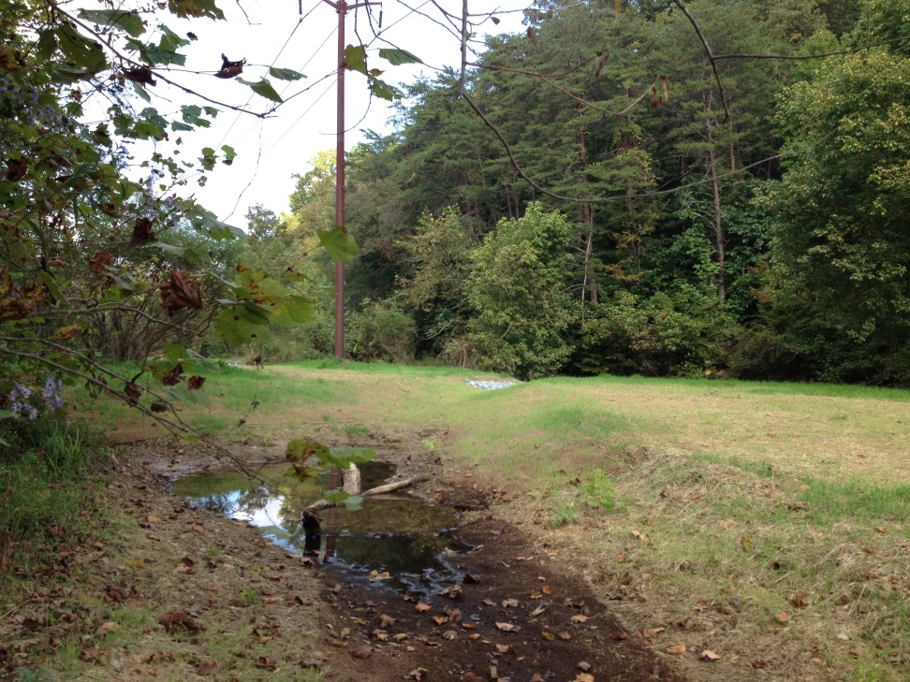
Streambanks Restored &
Oxbow Drainage Created

Slide 12
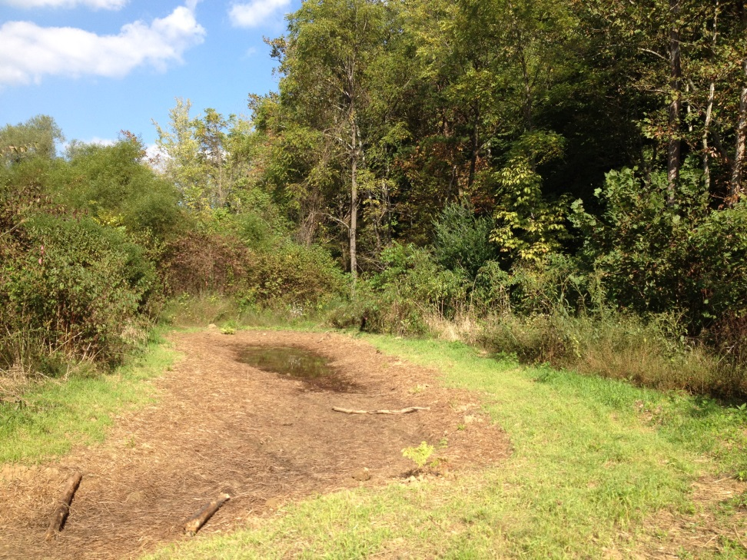
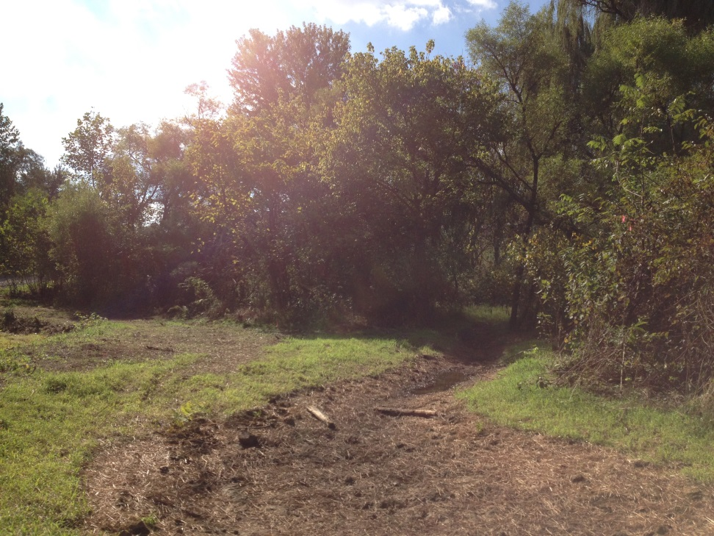
Vernal Pools to Enhance Wetlands

Slide 13
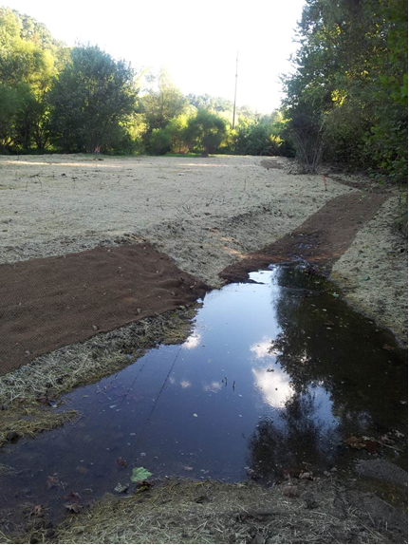
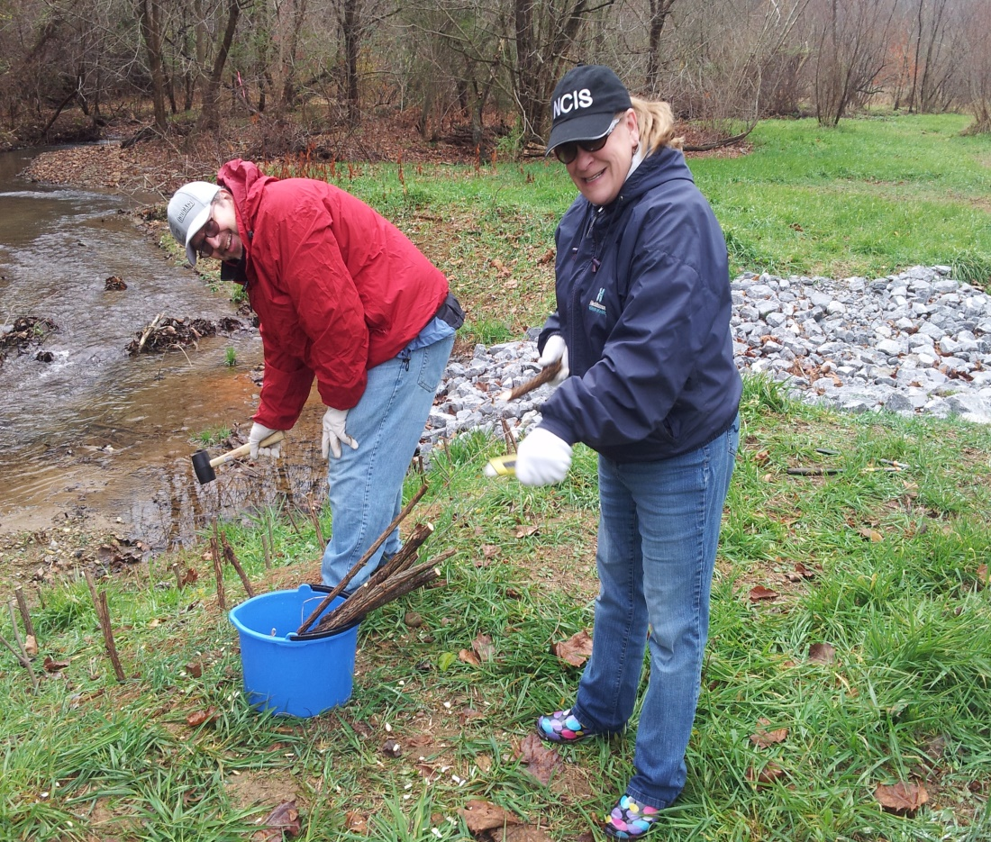
A constructed overflow channel with vernal pools in the wetlands.
Live stake were planted to stabilized streambanks.

Slide 14
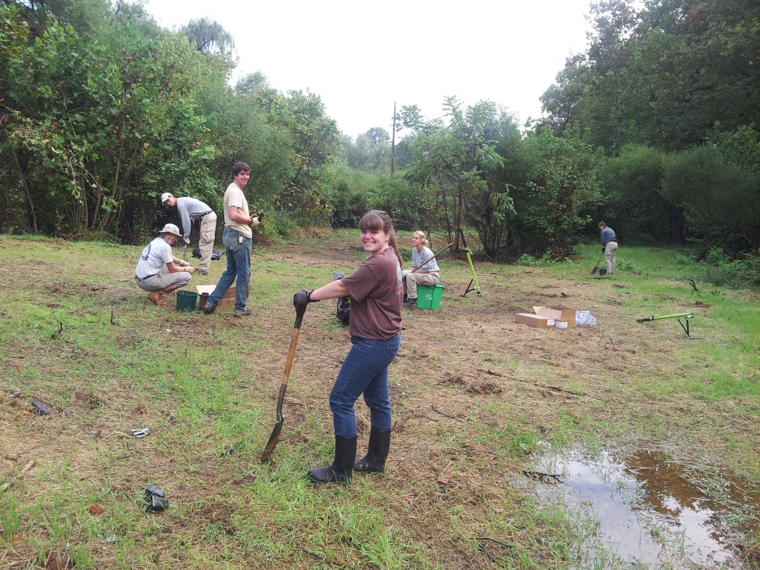
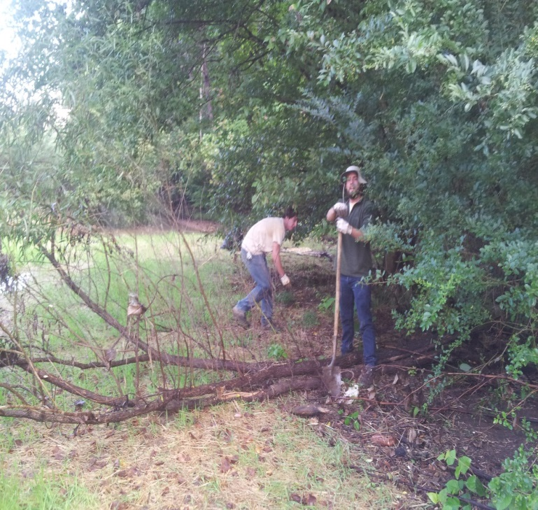
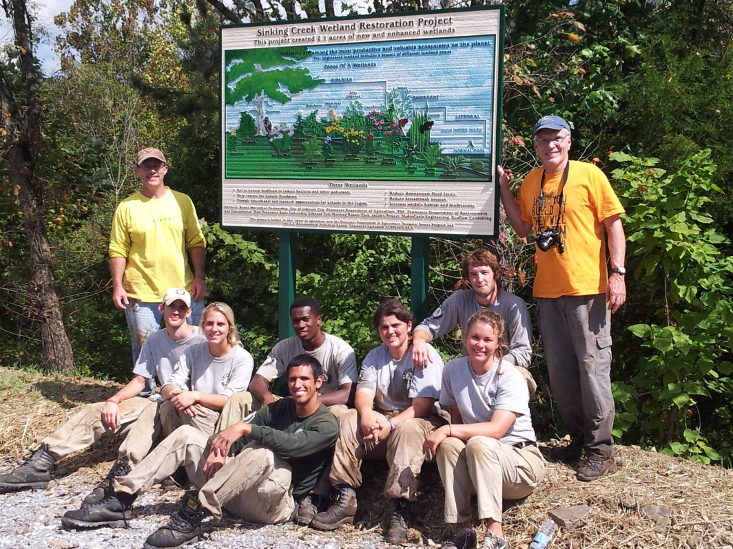
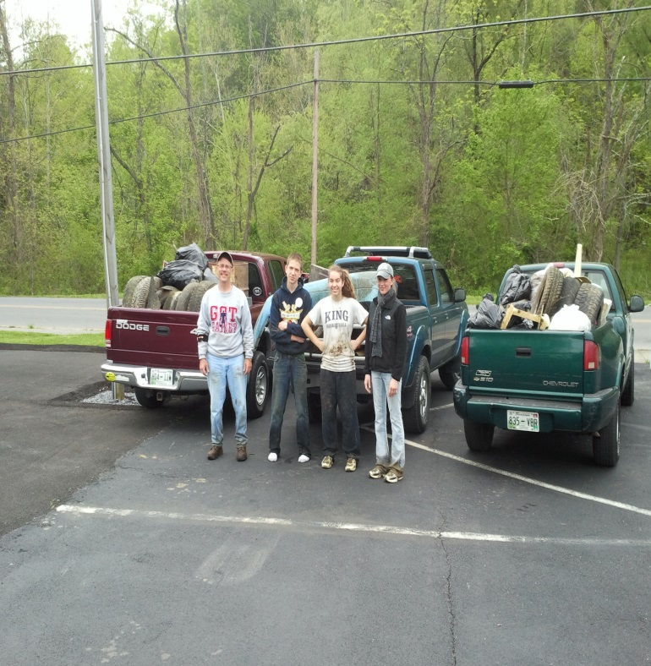
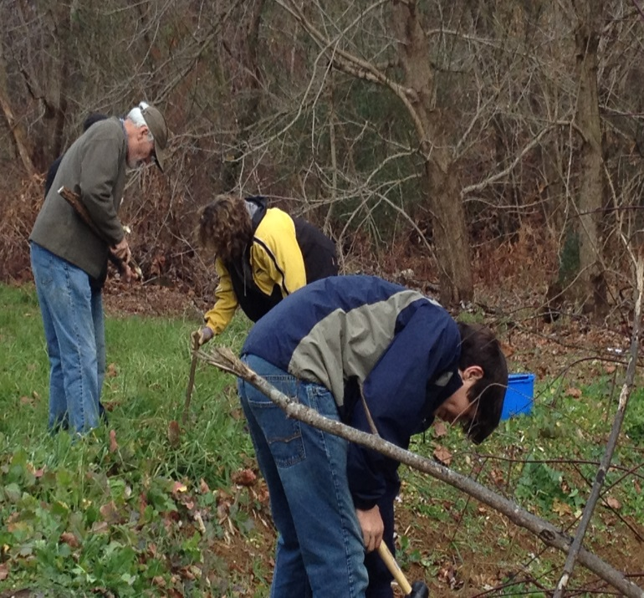
Volunteers Removed Litter and Invasive Plants & Replaced Them with Hundreds of Native Trees and Plants.

Slide 15
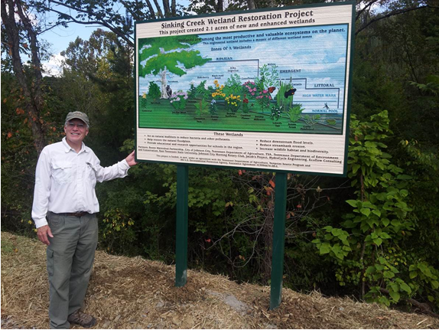
Interpretive Sign in Small Parking Lot Adjacent to the Wetlands.

Slide 16
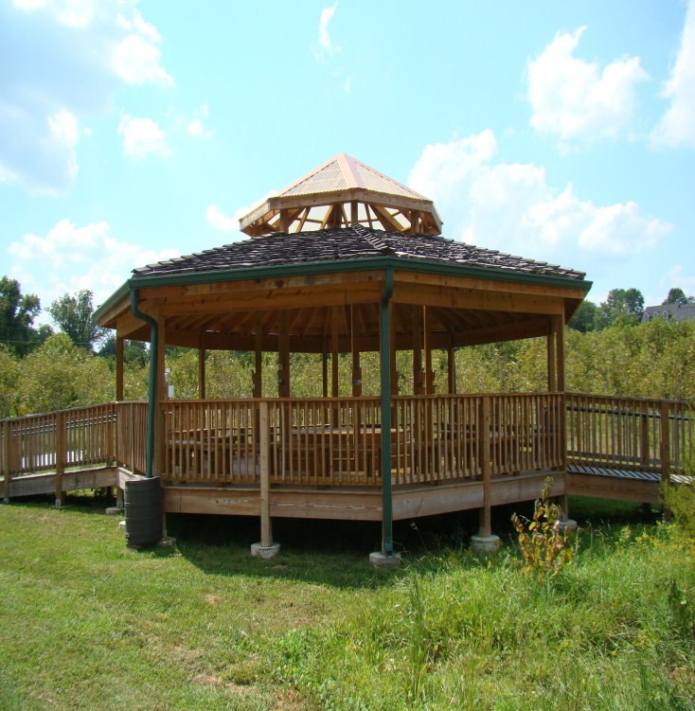
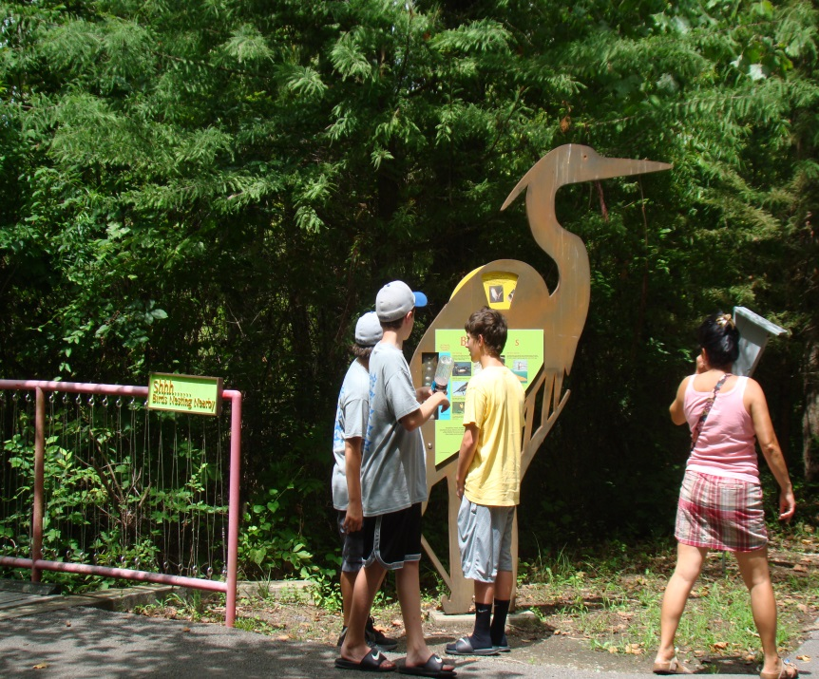
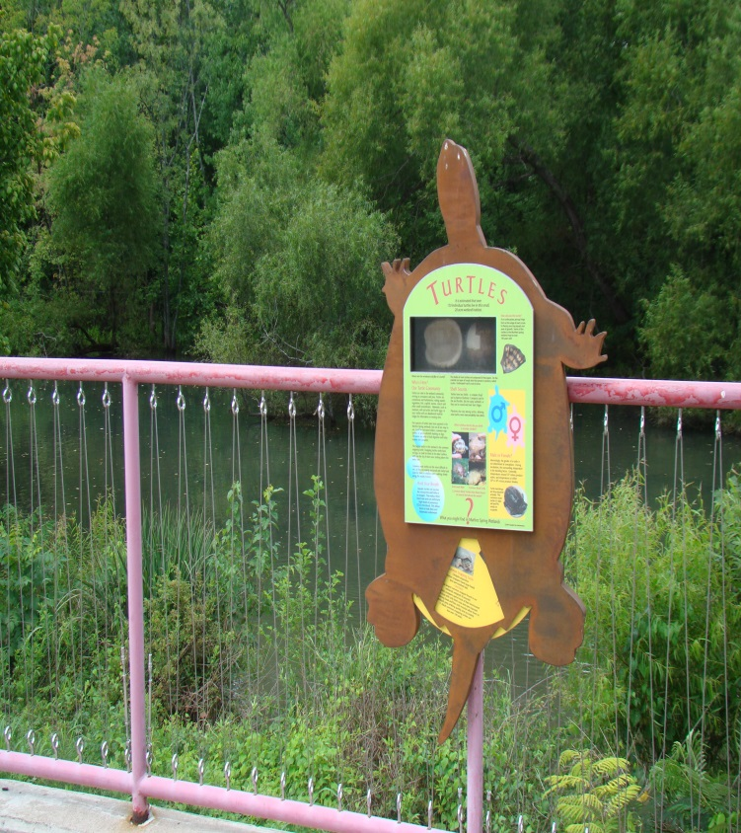
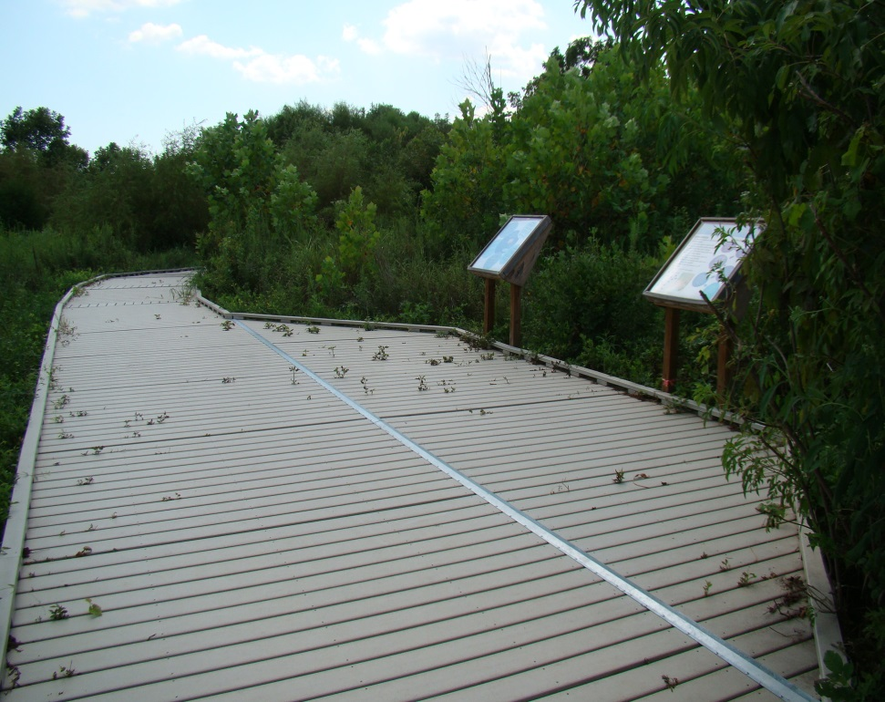
Sinking Creek Education Park
An Environmental Education Park at the wetlands site would help educate the public about water quality, serve as a resource for area schools, including ETSU, and be an asset to the community.

Slide 17
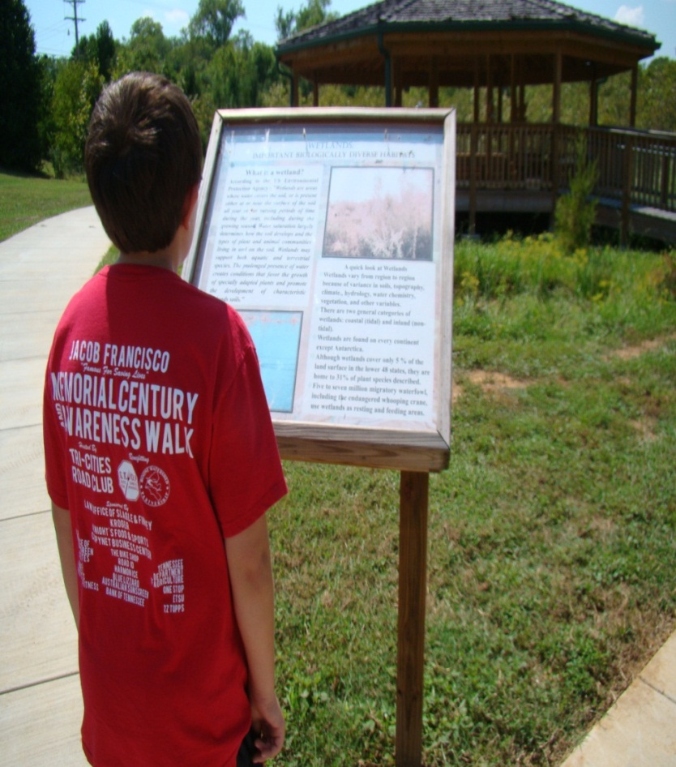
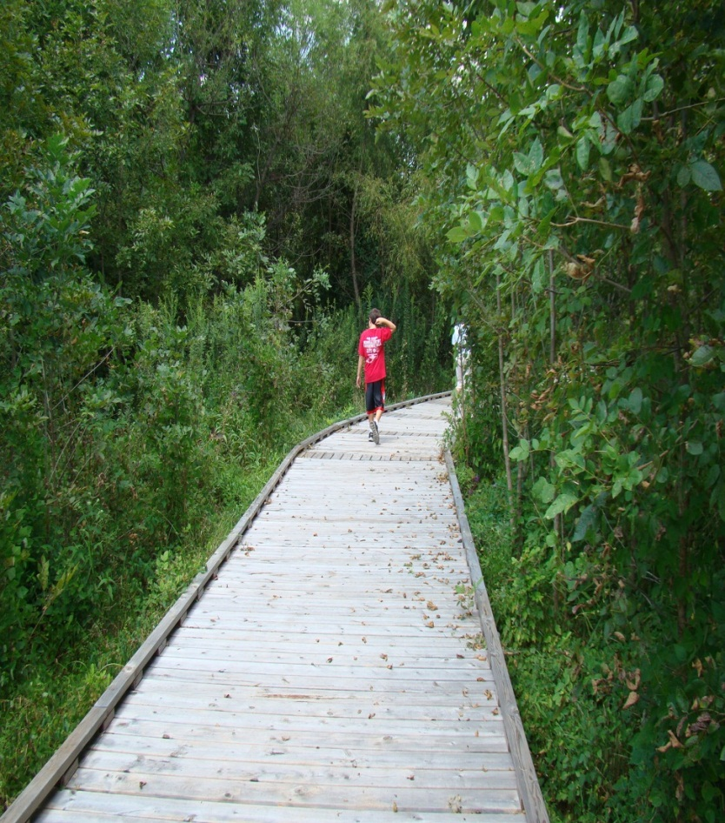
Imagine Interpretive Signs, Boardwalks and Trails Over Habitats

Slide 18
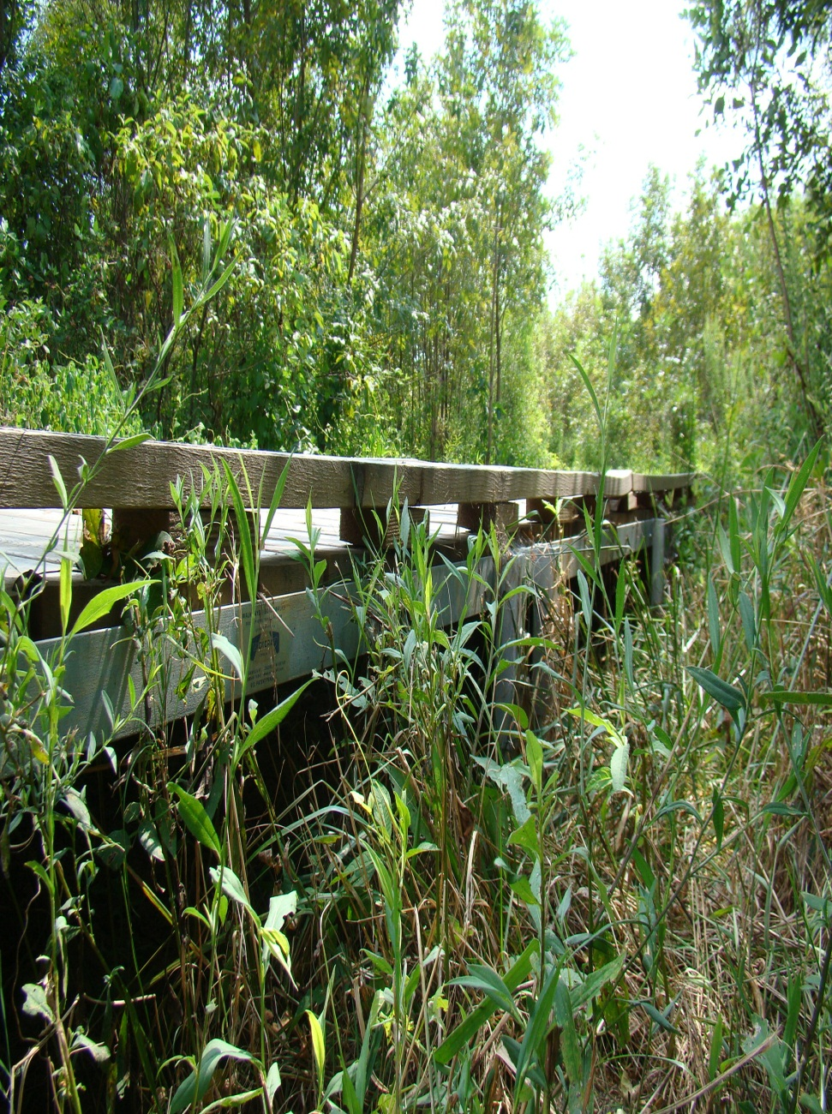
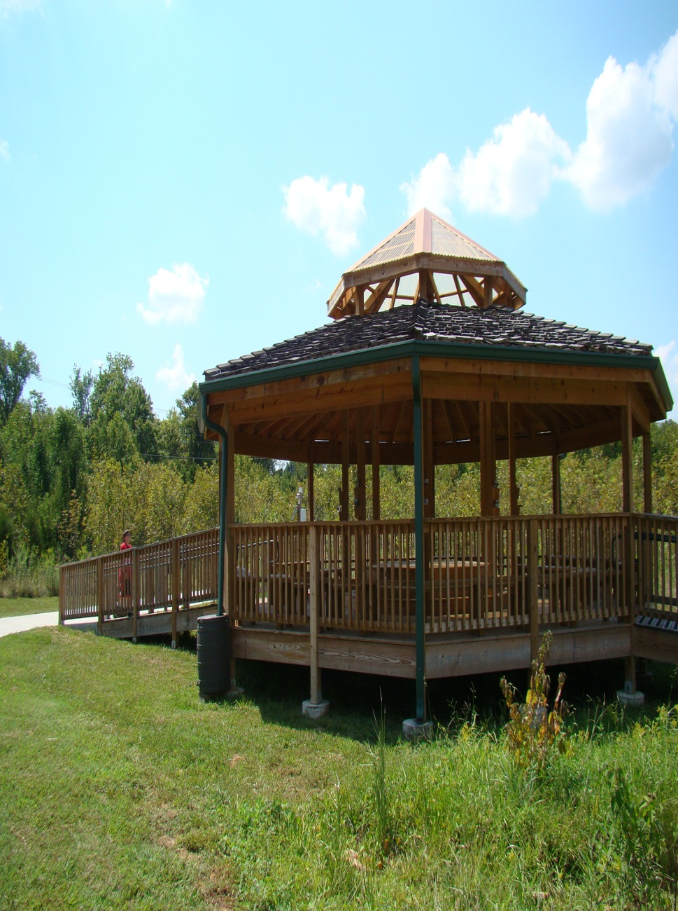
And an Outdoor Classroom Similar to
Pistol Creek in Maryville, Tennessee

Slide 19
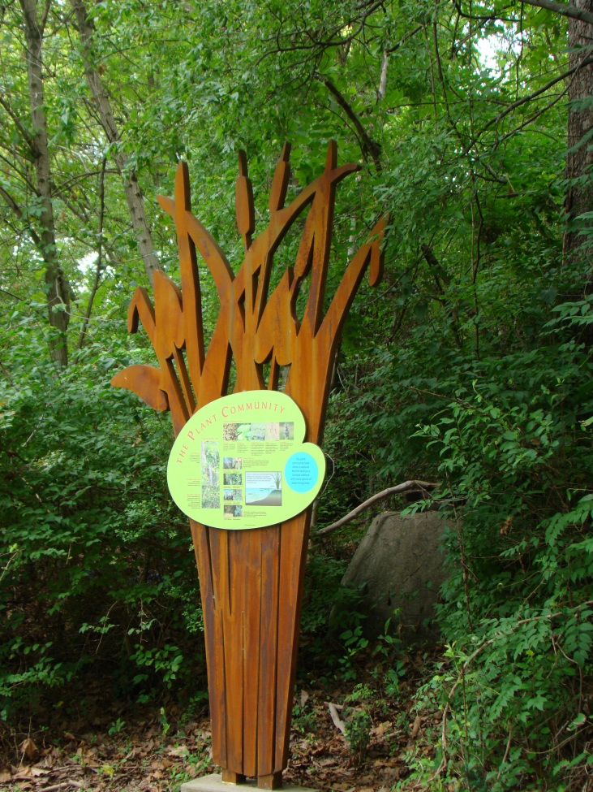
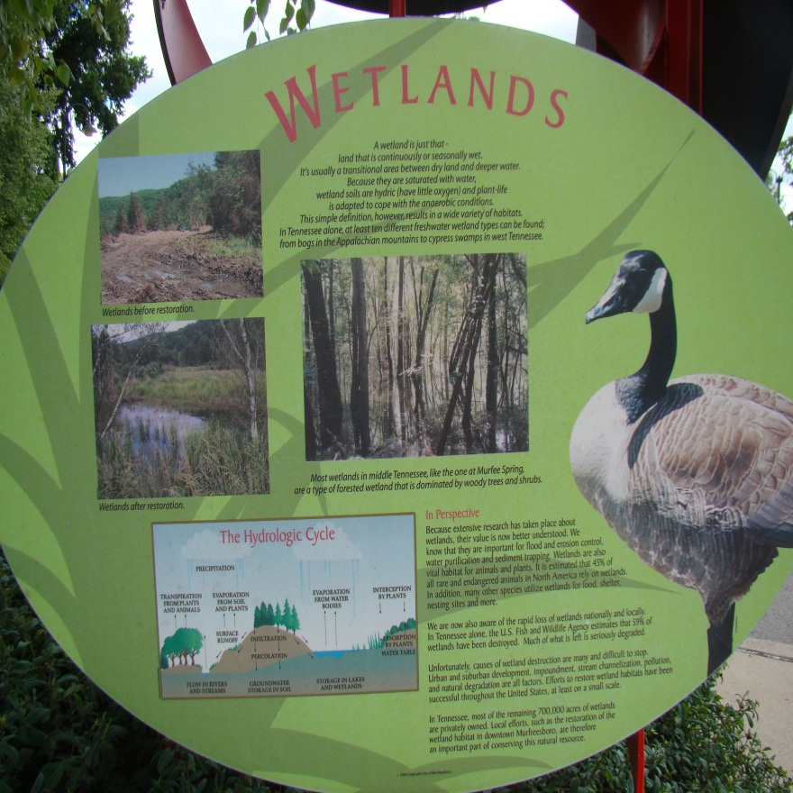
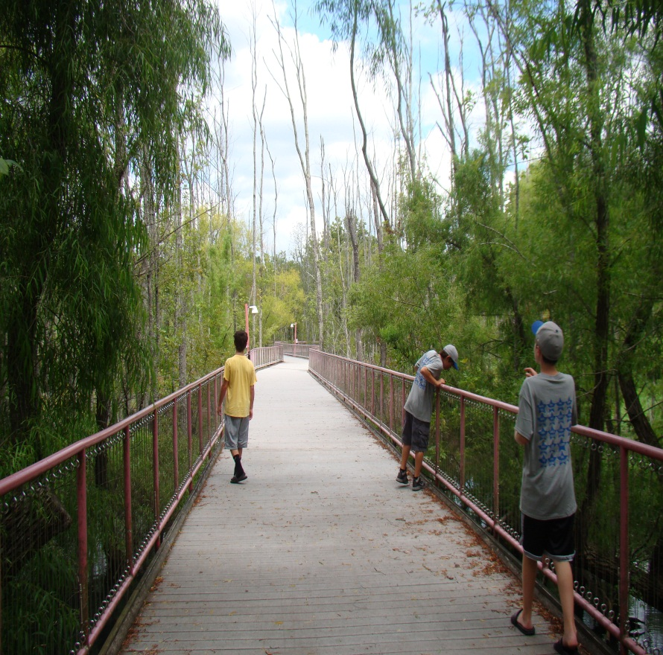
Or Similar to Murfree Springs Wetlands in Murfreesboro, Tennessee

Slide 20
Endorsements
Johnson City Parks & Rec Advisory Board
Johnson City School Board
City Commission of Johnson City
6 ETSU Departments
Tennessee Department of Conservation
Tennessee Department of Agriculture
Tennessee Valley Authority
Johnson City Morning Rotary Club
Johnson City Press

Slide 21
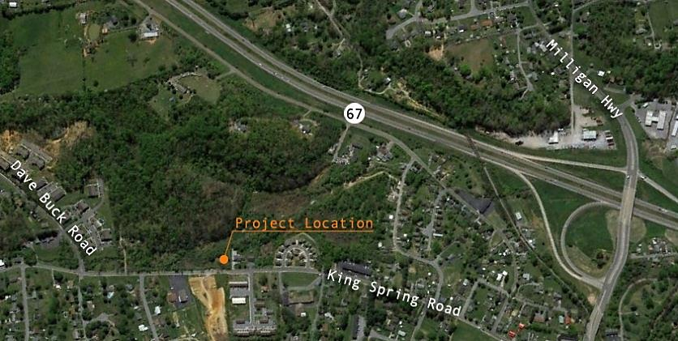
Location of Sinking Creek Education Park in Johnson City

Slide 22
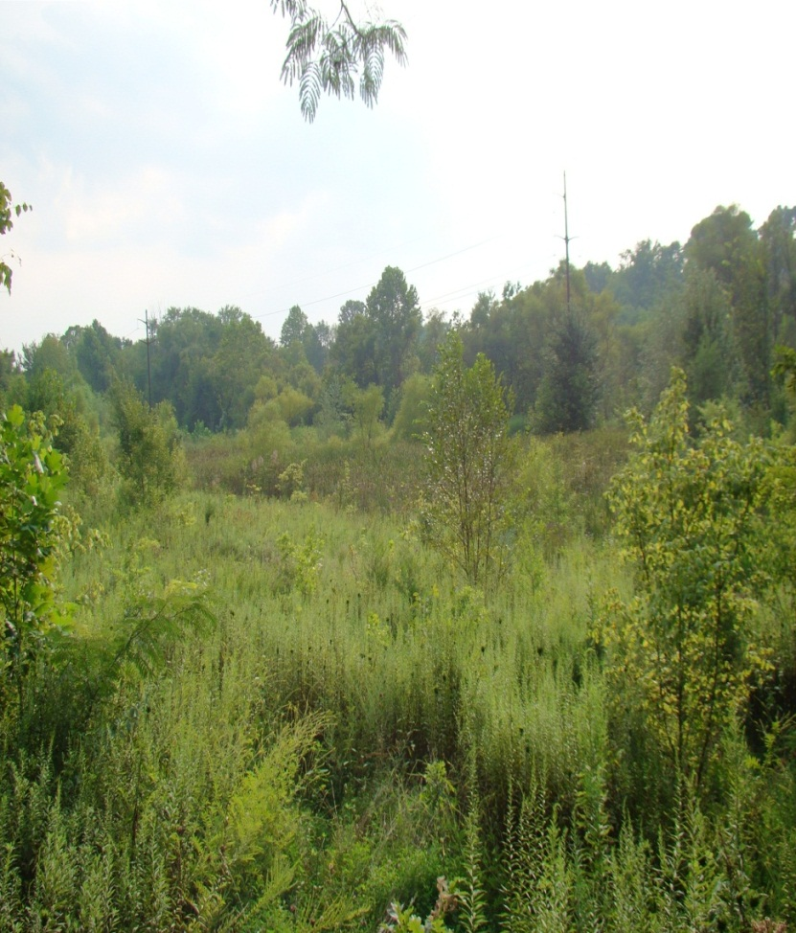
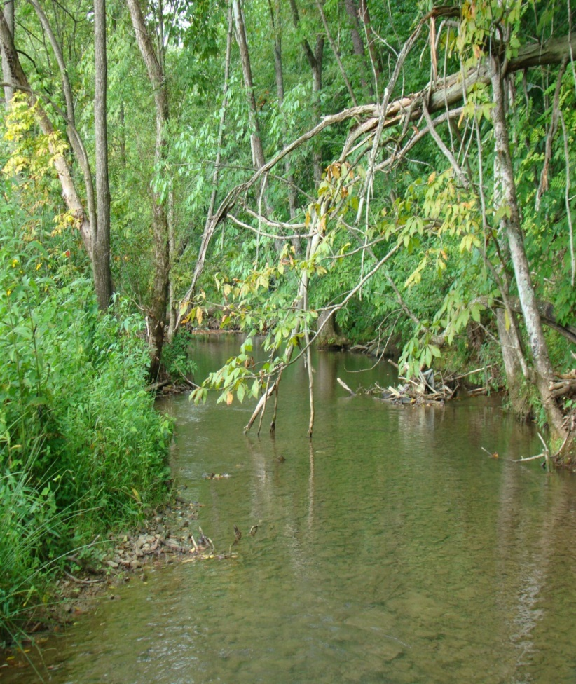
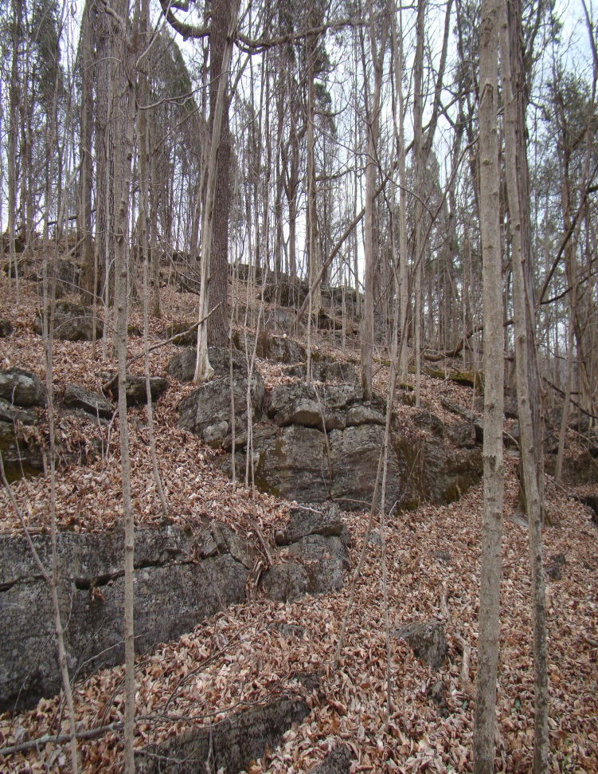
Beautiful 28 Acres of Diverse Forest, Geology/Geography, and Wetlands in an Urban Neighborhood

Slide 23
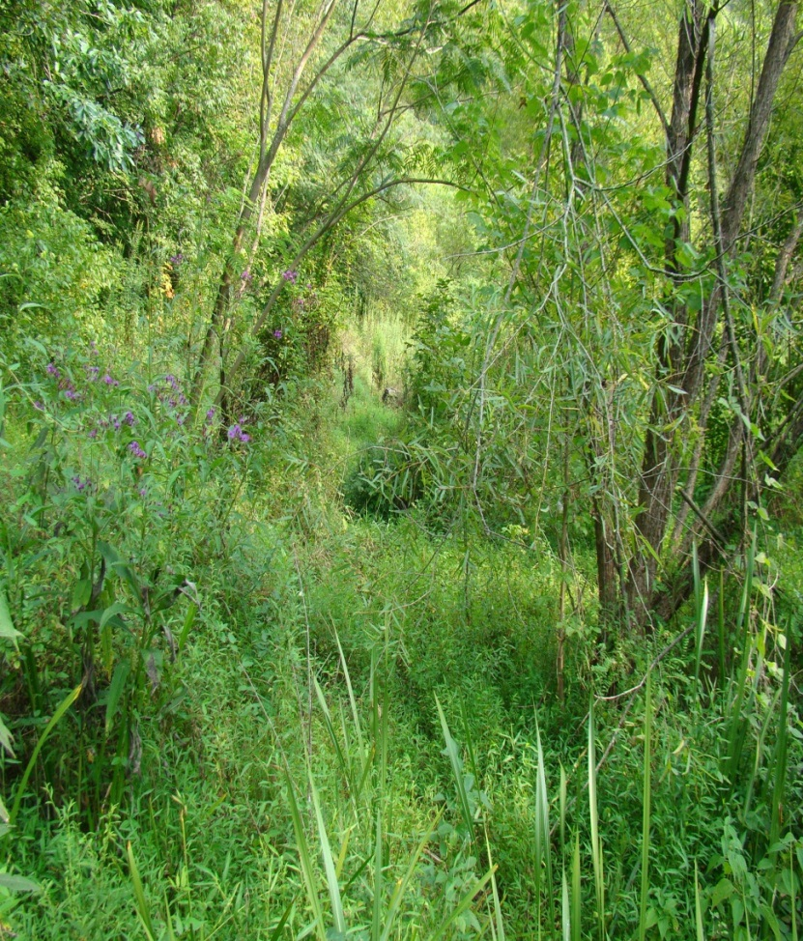
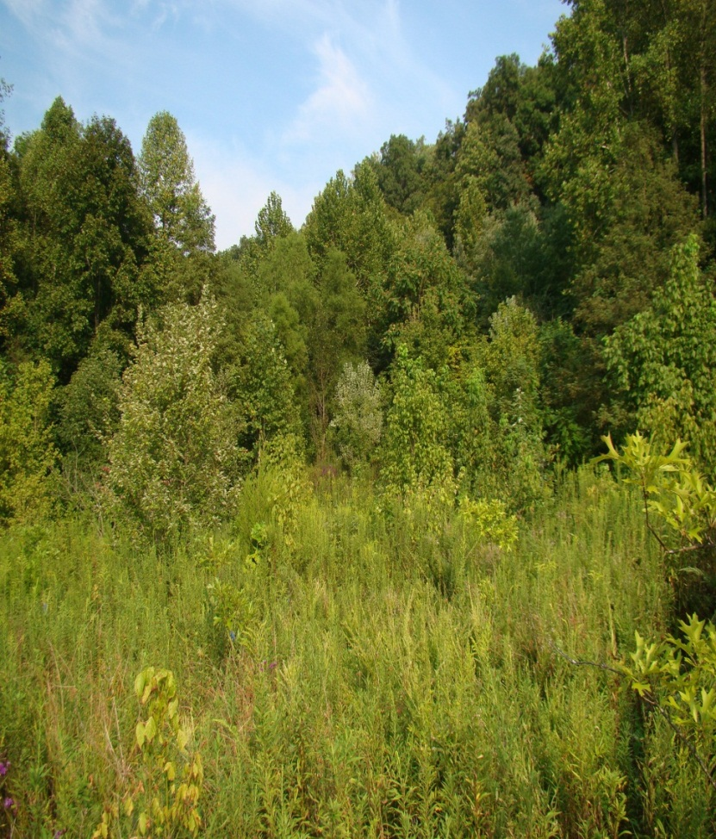
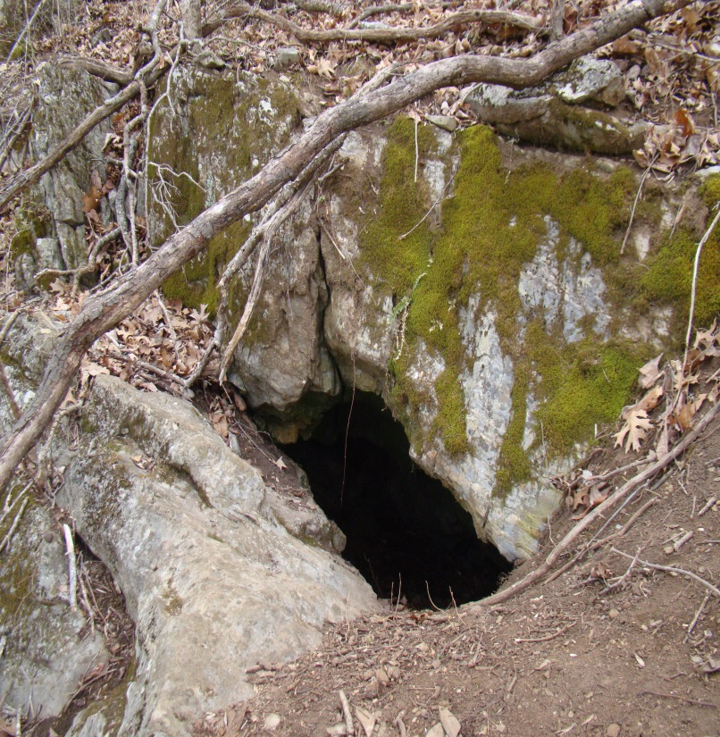
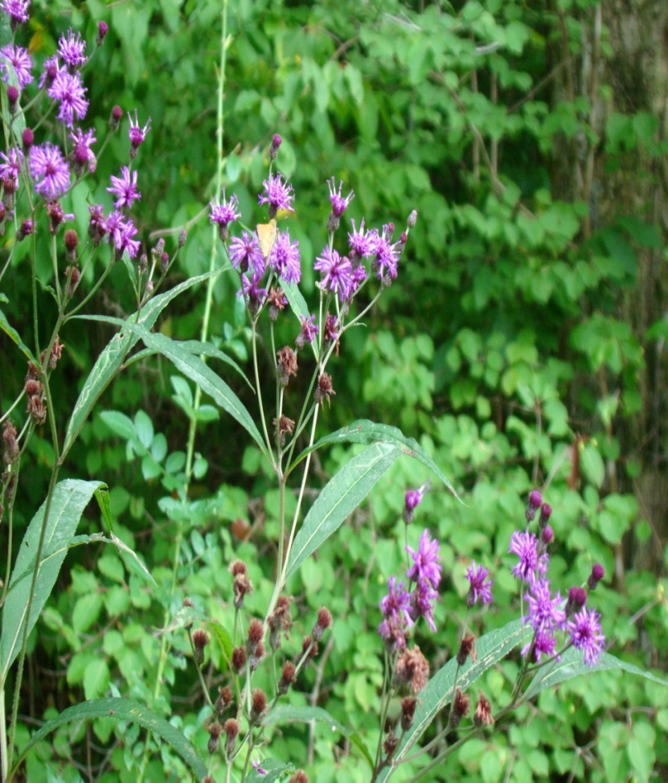
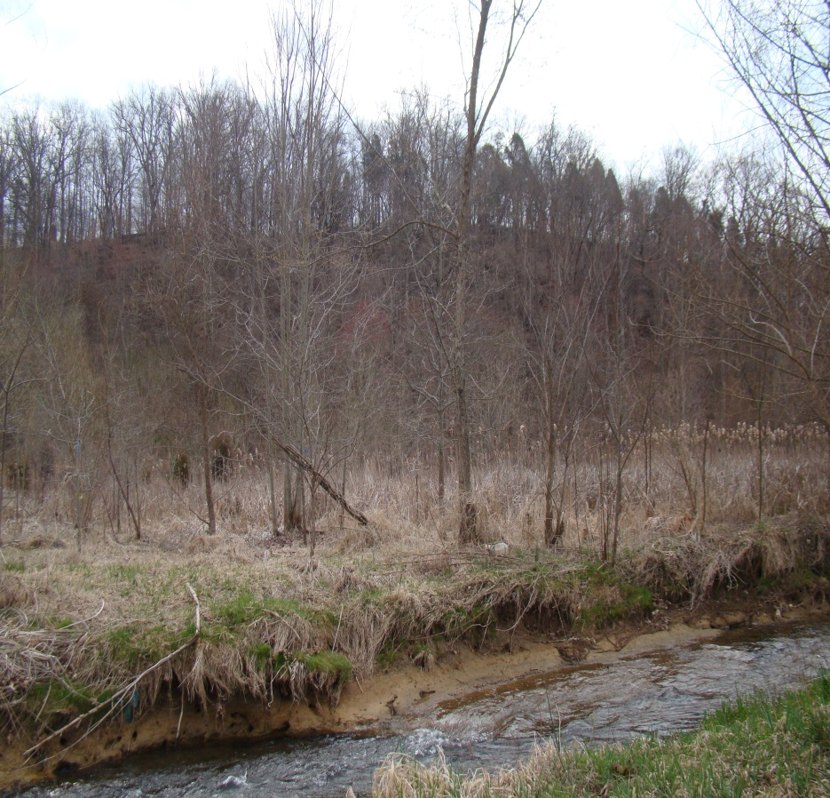
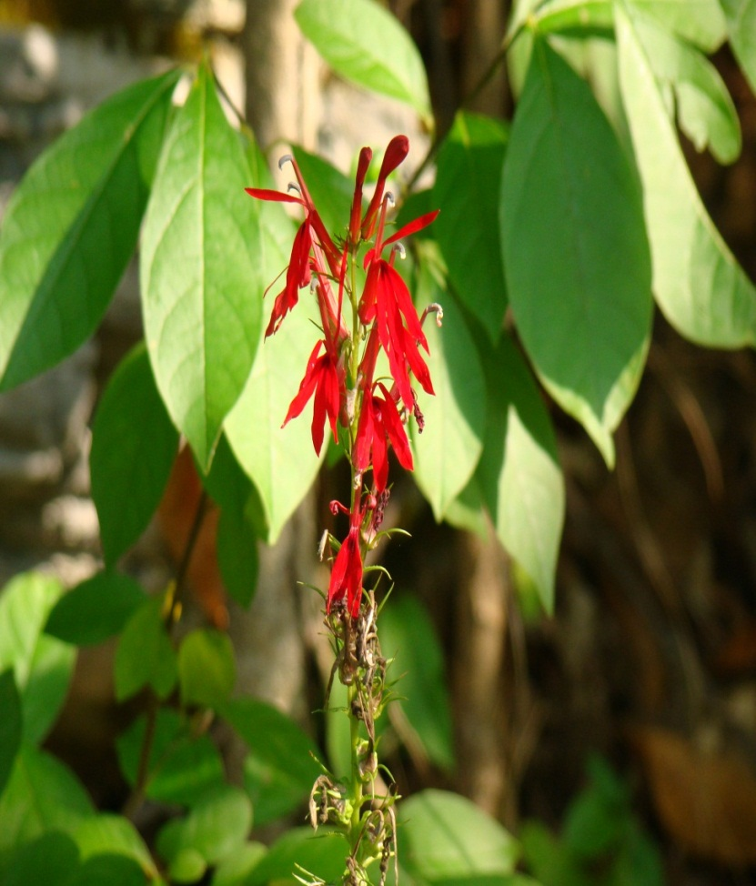

Slide 24
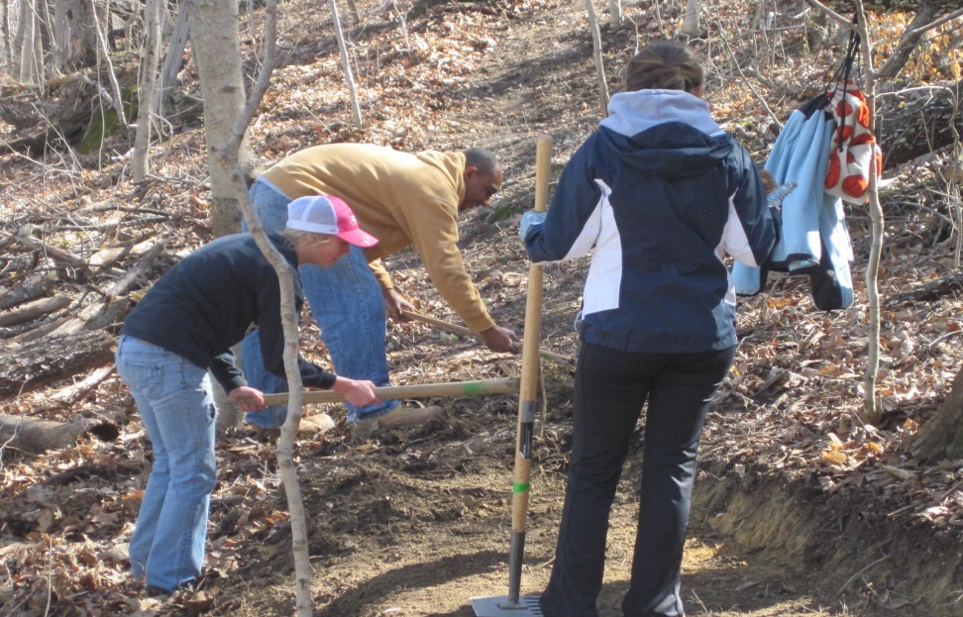
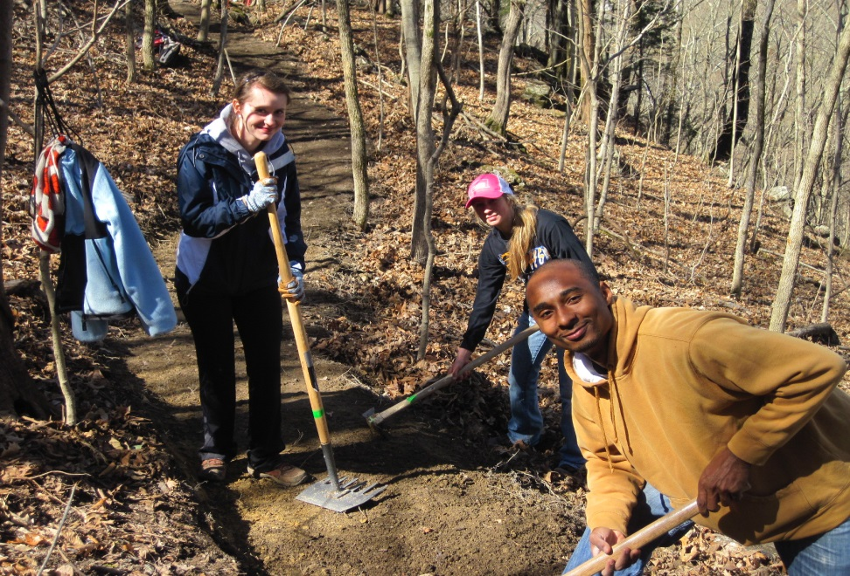


Sinking Creek Trailblazers from ETSU/Community Led by Johnson City Parks & Recreation Nature Program

Slide 25




Sinking Creek Education is Already Happening . . .
Imagine More!

Slide 26

Working to Get It Built
A preliminary design has been completed.
Partners have committed $166,348 in-kind and cash contributions to the project for pending grant applications.

Slide 27








Jacob’s Project Raises Park-Building Funds & Raises Awareness of E. Coli Bacteria

Slide 28

2014 Miss Tennessee Teen – Morgan Moseley Selects Jacob’s Project for Community Service

Slide 29


Jacob Francisco’s Legacy: To Be Famous for Saving Lives through Sinking Creek Education http://www.youtube.com/watch?v=ubLE4vllnlo&feature=share&list=UUFhMj_kHQ6iXprB9yfjlZGw

Slide 30
Help Fulfill A 6 Year-old Boy’s Declaration To Be Famous One Day
Walk or Pedal for Sinking Creek during Earth Week Saturday, April, 26, 2014: Registration and Info at www.jacobfrancisco.com
Contact: Bill Francisco: wlcisco@aol.com
Visit: www.jacobfrancisco.com
Write a tax-deductible check to: BWP-Sinking Creek, and mail it to Boone Watershed Partnership, c/o Matt Dake, 578 Beaver Creek Rd., Bluff City, TN 37618

