Slide 1
Jacob Francisco Memorial Century & Awareness Walk
To benefit the Boone Watershed and to build an Environmental Education Park at Sinking Creek
A leisurely 2-mile walk along the State of Franklin pathway.
Featuring an open-air art gallery created by Johnson City kids.
Also 25 mile and 100K non-competitive bicycle ride
Notes:
ANYBODY CAN PARTICIPATE!

Slide 2
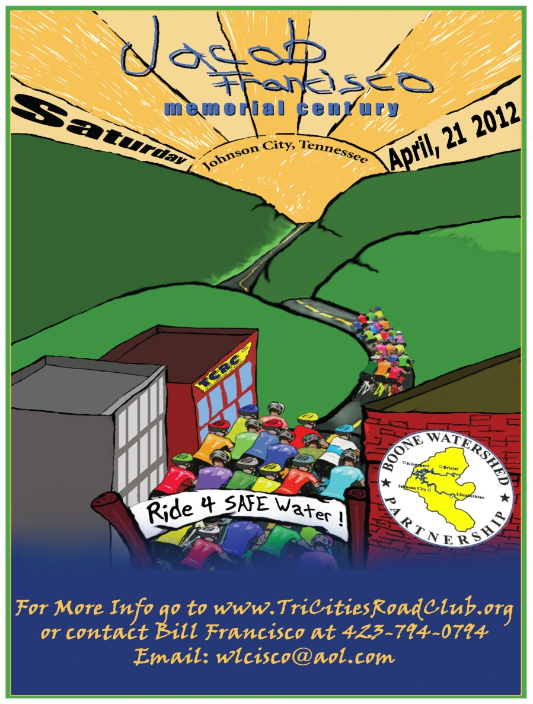
A SPECTACULAR BIG EVENT IN JOHNSON CITY
Notes:
Keep listening & watching to learn how you will be a very important part of this event! This event raises awareness about E. coli bacteria in Sinking Creek.

Slide 3
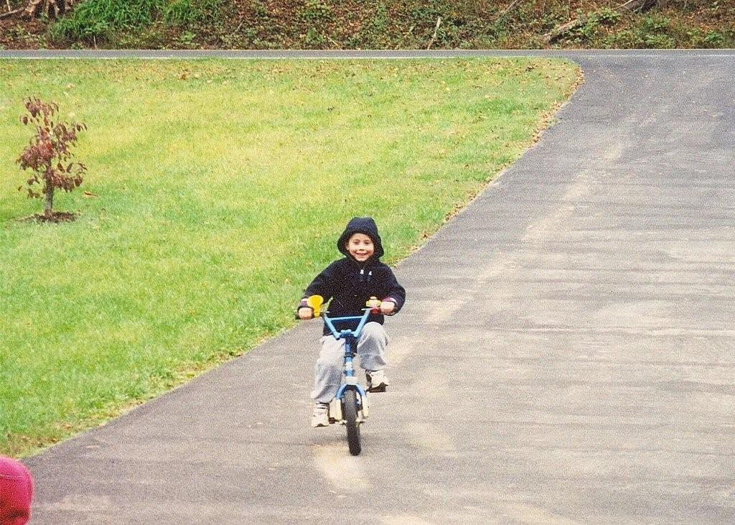
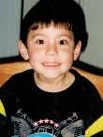
Who Is Jacob Francisco?
Notes:
He is a six-year old boy who loved kindergarten at Cherokee Elementary School. He loved playing soccer. He loved picking flowers and catching bugs for his mom. He loved riding his bike. He loved his friends and family. He is my son. He died from a bad E. coli bacteria.

Slide 4
NOW SAVING LIVES
A few months before he got sick, Jacob curiously announced to his parents that he would be famous one day.
When asked for what he would be famous, he responded, “I don’t know, but I’ll be on the covers of magazines.”
His family and friends have worked over 8 years trying to raise awareness in our region of the danger of certain E. coli bacteria.
As more people know about it, lives will be saved, and Jacob will be famous for saving lives.

Slide 5
What is Boone Watershed?
1st: What is a watershed?
A watershed is the area of land where all of the water that is under it or drains off of it goes into the same place.
This includes streams, creeks, rivers, surface water eventually emptying to the same place.
Notes:
Let’s learn some facts before we get to the big event.

Slide 6
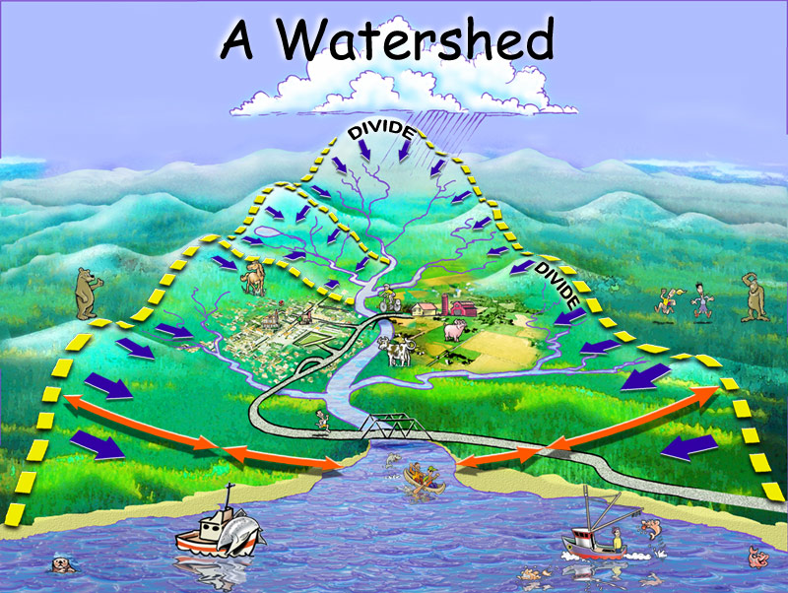
A Model of a Watershed
Notes:
Notice the mountain streams flowing into rivers that are flowing into a lake.

Slide 7
Boone Watershed Facts
The Boone Watershed below South Holston and Watauga Dams is about 670 square miles.
The local watershed lies in two states and four counties.
It includes the cities of Bristol TN and VA, Blountville, Bluff City, Johnson City, and Elizabethton.
Boone probably has the most densely populated and heavily developed watershed of any TVA reservoir.
Notes:
Sinking Creek flows for almost 10 miles from Buffalo Mountain into the Watauga River, which flows into Boone Lake.

Slide 8
Why is Sinking Creek Important to Boone Watershed?
It starts flowing from its origin on Buffalo Mountain above Johnson City.
It flows past many businesses, farms, and homes near Cherokee and Mountain View Elementary Schools.
At the end of its almost 10 mile journey, it empties into Watauga River.
Watauga River empties into Boone Lake.
Notes:
Many kids could be wading in the stream catching crawdads, salamanders, and minnows. There are some places along Sinking Creek where many wild raspberries grow along its banks. Some people could water their vegetable garden from Sinking Creek.

Slide 9
LISTEN GOOD HERE!!
Sinking Creek is contaminated with dangerous bacteria called E. coli.
Some places of Sinking Creek downstream from Mountain View Elementary School have so much E. coli bacteria that the government has posted WARNING signs.
Notes:
E. coli bacteria can make us sick, and even kill some people.

Slide 10
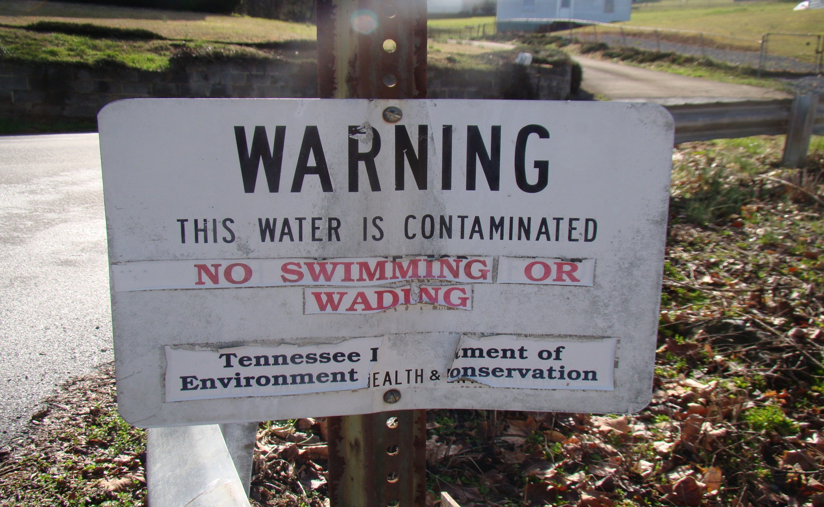
BEWARE AT SINKING CREEK
Notes:
The Tennessee Department of Environment & Conservation has posted signs along Sinking Creek within a mile downstream from Mountain View Elementary School in Johnson City.

Slide 11
What Is E. Coli Bacteria?
A one-celled organism that lives in the gut of animals, including humans.
Most E. coli bacteria are not harmful to humans, and some are necessary for digestion.
Other types of E. coli bacteria are harmful causing illness, and death.
Notes:
An illness called Hemolytic Uremic Syndrome (HUS) that causes the human body organs to stop functioning is caused by certain dangerous E. coli bacteria. This is not a rare illness since it is the leading cause of kidney failure in America’s children.

Slide 12
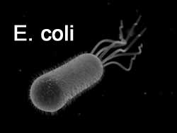
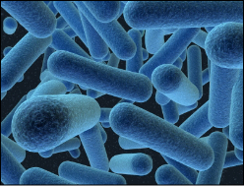
One-Celled Organism
That Multiplies

Slide 13
Where Does the
Bad E. Coli Come From?
It comes from POOP, most often found from cattle.
It has been found in other animal poop such as deer, and other farm animals.
Notes:
How does bad E. coli get into humans?

Slide 14
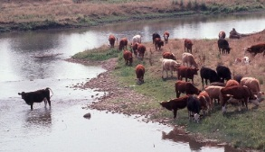
LOOK & REMEMBER
Notes:
Is it a good idea to water your tomato plants from this creek with cows pooping in it?

Slide 15
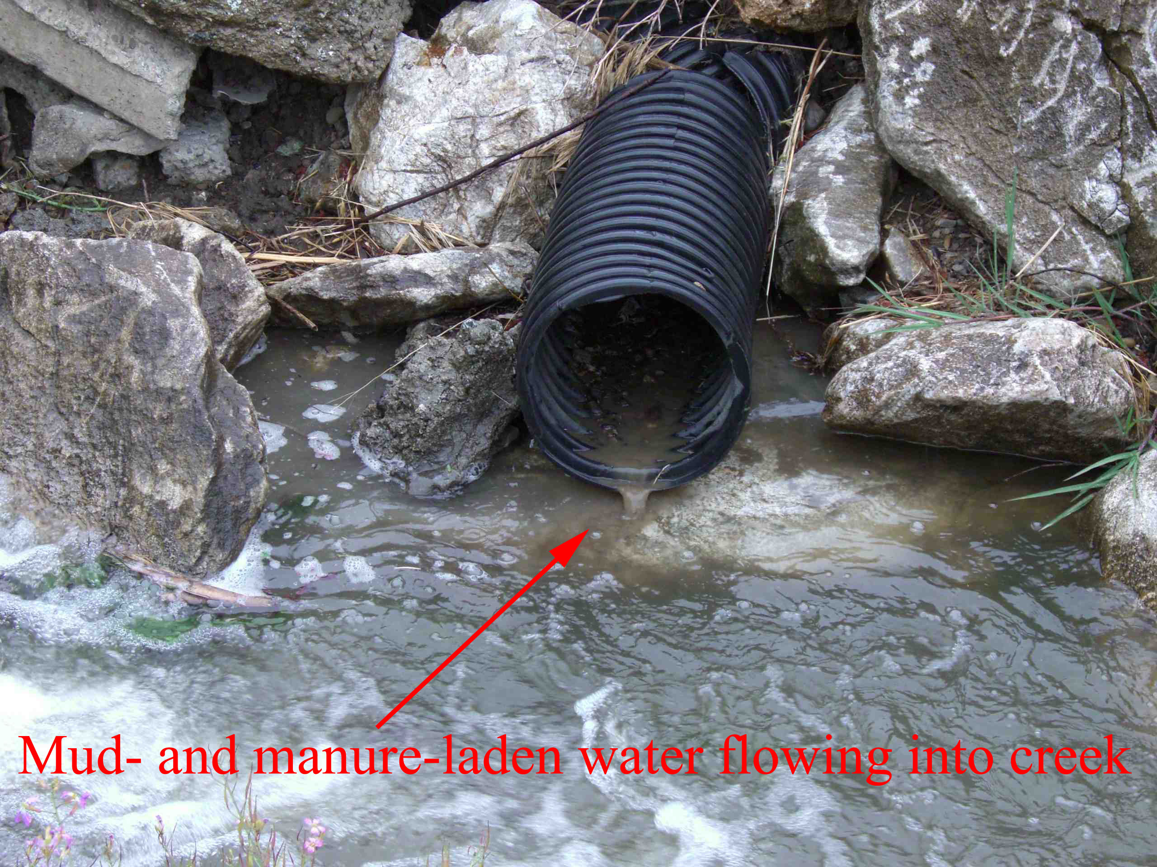
Notes:
Should we wash ourselves with soap & water after wading in this stream catching minnows, crawdads, and salamanders?

Slide 16
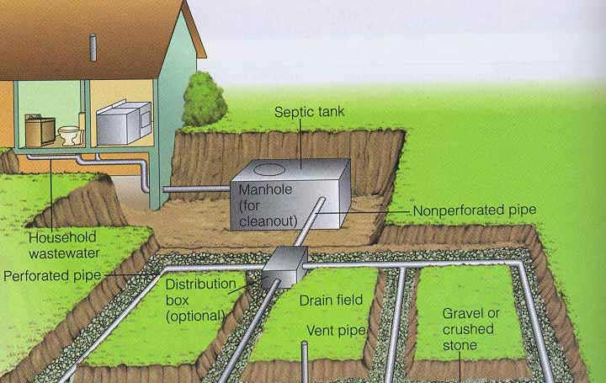
Notes:
This septic system does not have a leaky or overfilled tank near a stream; unlike many that were found along Sinking Creek in Johnson City.

Slide 17
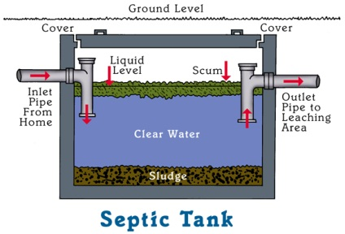
Notes:
What would happen if this septic tank was near a stream and it was old and cracked?

Slide 18
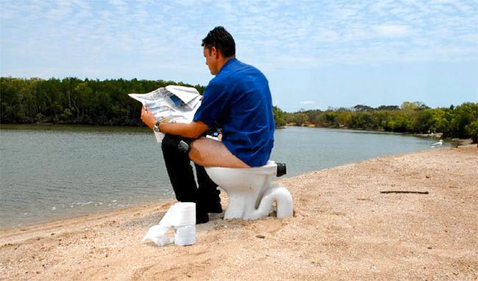
Notes:
Having a leaky septic system near the creek is no different than this picture.

Slide 19
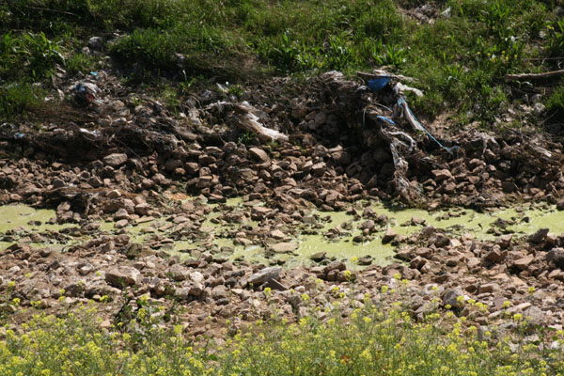
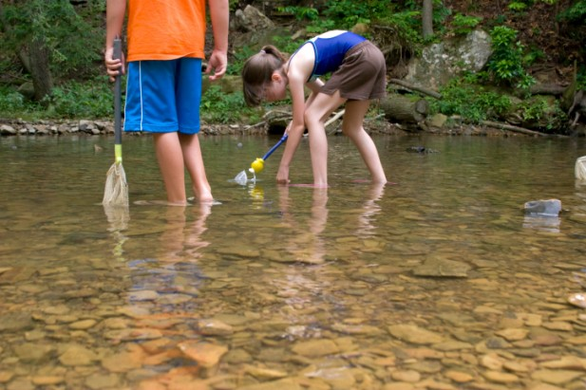
Both Streams Could Have
E. Coli Bacteria

Slide 20
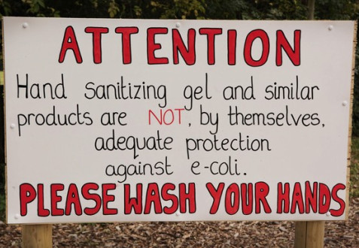
PLAY, PLAY AGAIN, AND
WASH HANDS, WASH AGAIN
Notes:
Always wash your hands with soap & water after petting or handling animals. Hand sanitizers at petting zoos are not enough.

Slide 21
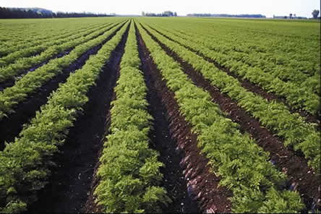
FARMERS NEED TO BE FAMILIAR
WITH IRRIGATION SOURCE
Notes:
A good discussion to have at your farmer’s market.

Slide 22
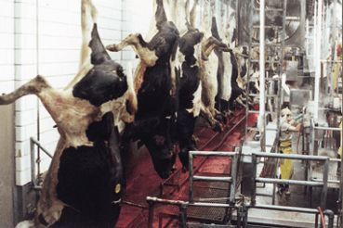
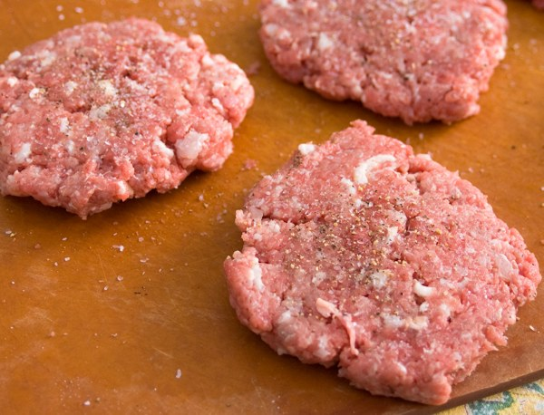
ALWAYS COOK WELL
Notes:
What was once on the outside, could be on the inside!

Slide 23
CLEAN FOR SAFE FOOD
WASH hands with warm water and soap for 20 seconds before and after handling food.
WASH cutting boards, dishes, utensils, and counter tops with hot soapy water after preparing each food item and before you go on to the next food.
RINSE fruits and vegetables under running tap water, including those with skins and rinds that are not eaten.
RUB firm-skin produce (or scrub with clean brush) under running tap water.
BLOT produce dry with a clean cloth towel or paper towel.
For more information on CLEAN, go to www.fightbac.org.
Notes:
Prevent contamination by washing hands, kitchen tools, fruits & vegetables.

Slide 24
SEPARATE FOR SAFE FOOD
KEEP raw meat, poultry, seafood and their juices apart from other food items in your grocery cart.
USE one cutting board for raw meat, poultry and seafood and another for salads and ready-to-eat food.
STORE raw meat, poultry, and seafood in a container or on a plate so juices can't drip on other foods.
For more information on SEPARATE, go to www.fightbac.org.
Notes:
Prevent contamination by always separating meats from rest of food.

Slide 25
COOK PROPERLY FOR SAFE FOOD
USE a food thermometer — you can't tell food is cooked safely by how it looks.
FOOD is safely cooked when it reaches a high enough internal temperature to kill the harmful bacteria that causes illness.
REFER to temperature chart.
For more information on COOK, go to www.fightbac.org.
 | Internal Temperature
Ground Meat & Meat Mixtures
Beef, Pork, Veal, Lamb | 160 °F
Turkey, Chicken | 165 °F
Fresh Beef, Veal, Lamb, Pork
Medium Rare | 145 °F with a 3 min. rest time
Medium | 160 °F
Well Done | 170 °F
Poultry
Chicken & Turkey, whole | 165 °F
Poultry parts | 165 °F
Duck & Goose | 165 °F
Stuffing (cooked alone or in bird) | 165 °F
Eggs & Egg Dishes
Eggs | Cook until yolk & white are firm
Egg dishes | 160 °F
Seafood
Fin Fish | 145 °F flesh is opaque
Shrimp, Lobster & Crabs | flesh pearly & opaque
Clams, Oysters & Mussels | Shells open during cooking
Scallops | milky white or opaque & firm
Leftovers & Casseroles | 165 °F
Notes:
Prevent contamination by cooking meats to proper temperature.

Slide 26
CHILL FOR SAFE FOOD
CHILL leftovers and takeout foods within 2 hours.
KEEP the fridge at 40 °F or below and use an appliance thermometer.
THAW meat, poultry, and seafood in the fridge, not on the counter, and don't overstuff the fridge.
For more information on CHILL, go to www.fightbac.org.
Notes:
Prevent bacteria growth by chilling leftovers and thawing frozen meat in refrigerator.

Slide 27
SINKING CREEK IS BEING RESTORED
Over 20 old septic tanks along the shore of Sinking Creek have been filled and the homes have connected to city sewer system.
One large pasture with Sinking Creek running through it has been fenced to keep cattle out of the stream.
An Environmental Park at Sinking Creek Wetlands is going to be built.
Notes:
An organization called the Boone Watershed Partnership has taken the lead with the City of Johnson City and East Tennessee State University to restore Sinking Creek to the way it was before leaky septic systems and cattle pooping in it. Refer back four slides to show septic systems.

Slide 28
You Can Be A Part of Jacob’s Awareness Campaign To Save Lives!!
Create an artistic, bright, eye-catching campaign sign that will be seen by hundreds, maybe thousands of people from the Jacob Francisco Memorial Awareness Walk on Saturday, April 20, 2013.
Talk to your family about walking or pedaling in the Jacob Francisco Memorial Century & Awareness Walk.
Go to www.jacobfrancisco.com for more information about Jacob’s event. Also visit and “like” his facebook community page at www.facebook.com/jacobfrancisco.awareness.
Notes:
Review images for potential artwork ideas.

Slide 29
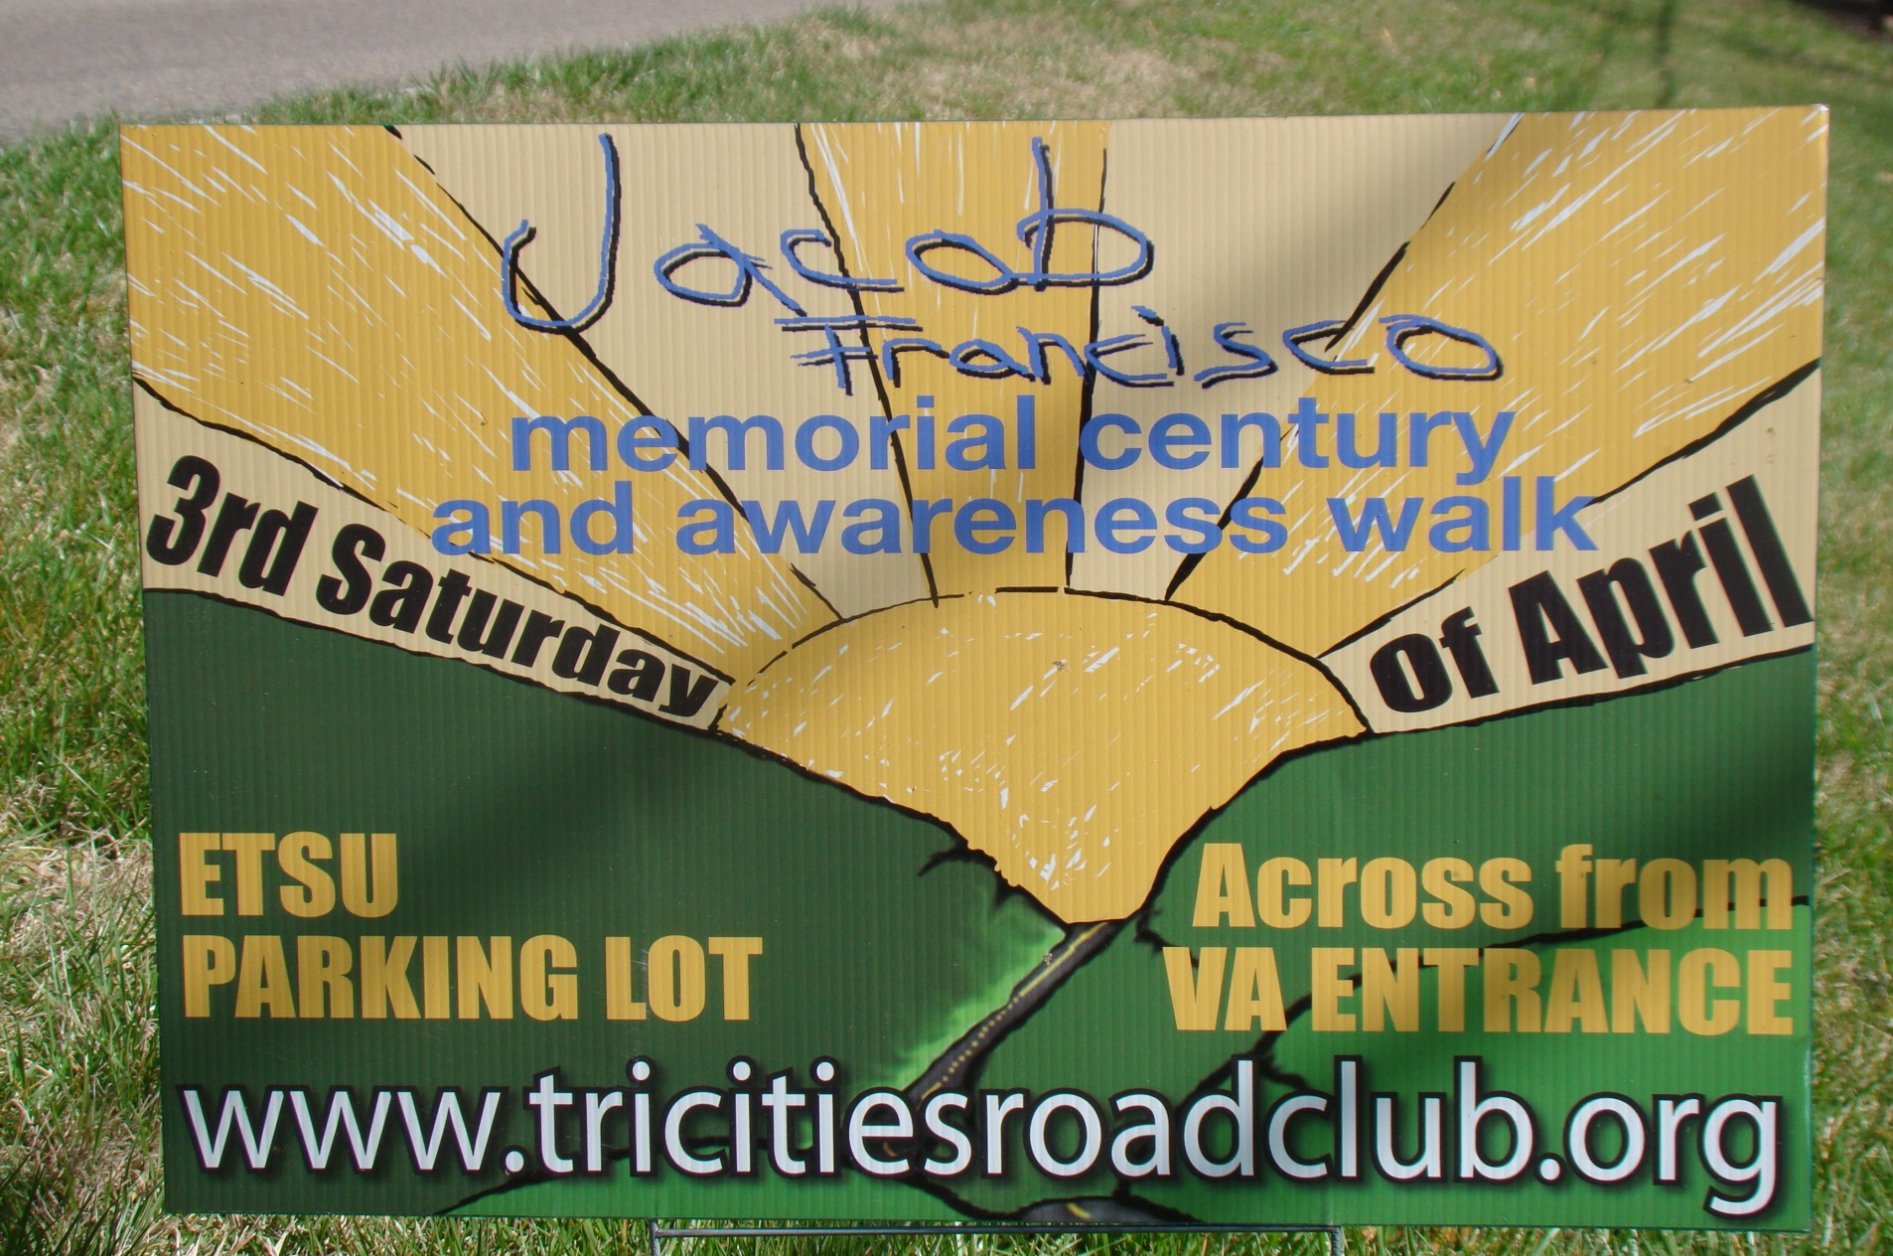
DON’T MISS THE EVENT

Slide 30
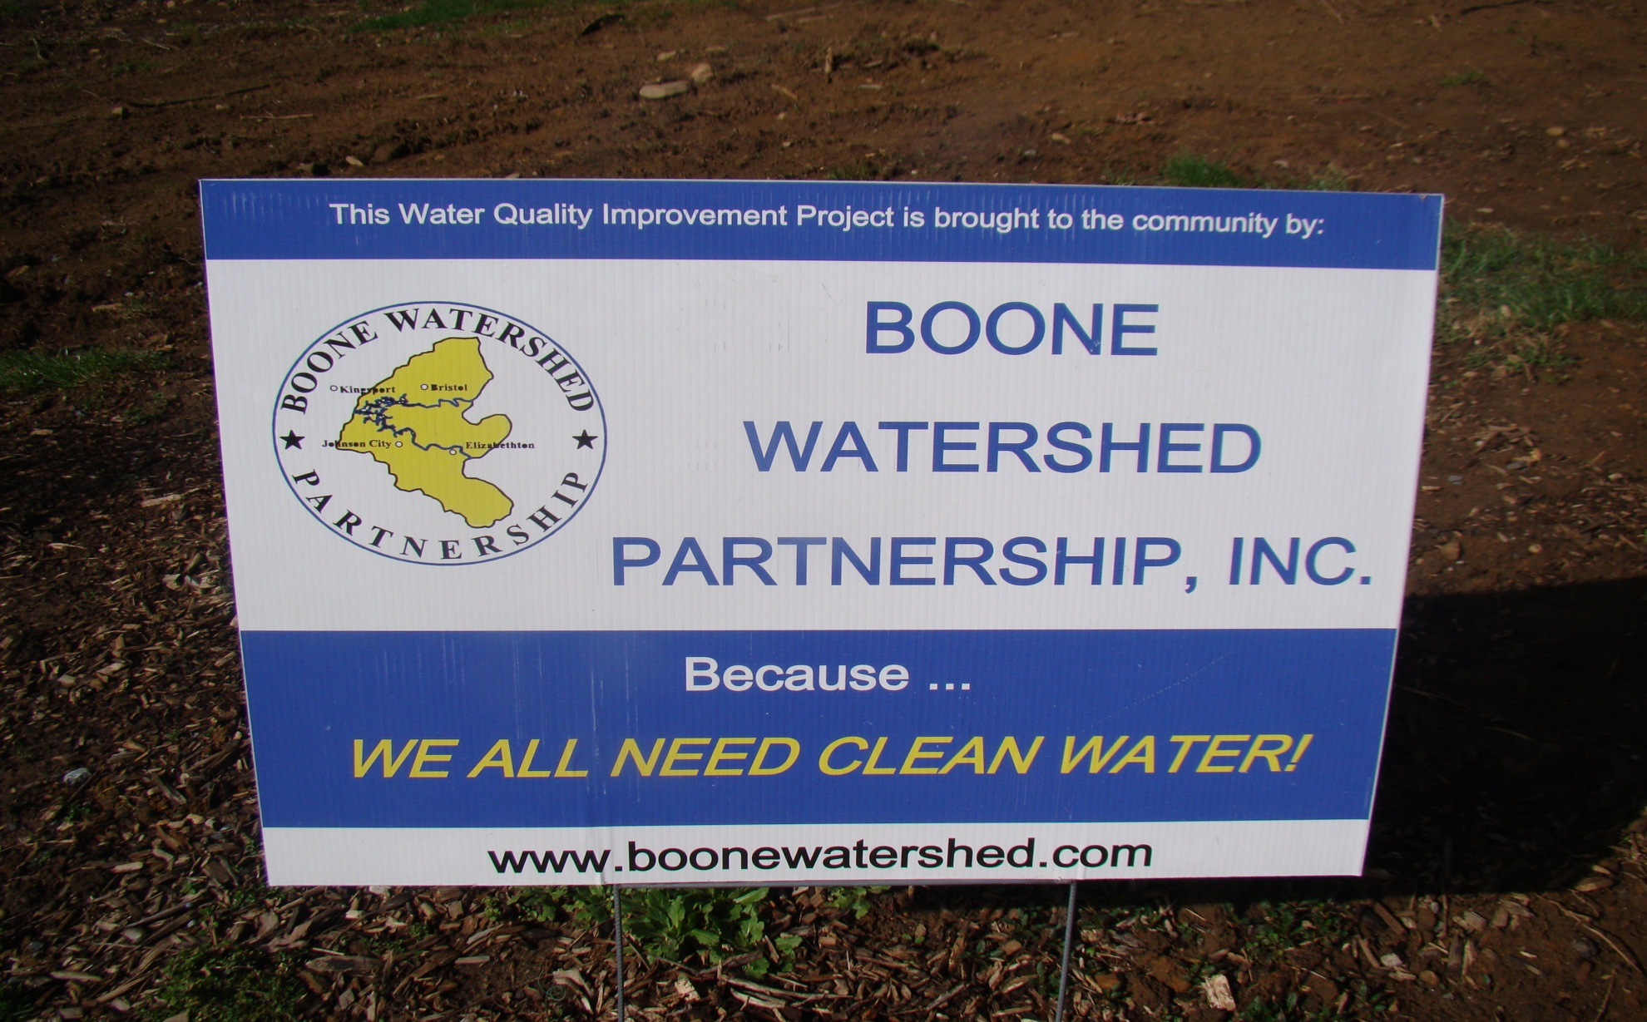
Working Together For Clean Water

Slide 31
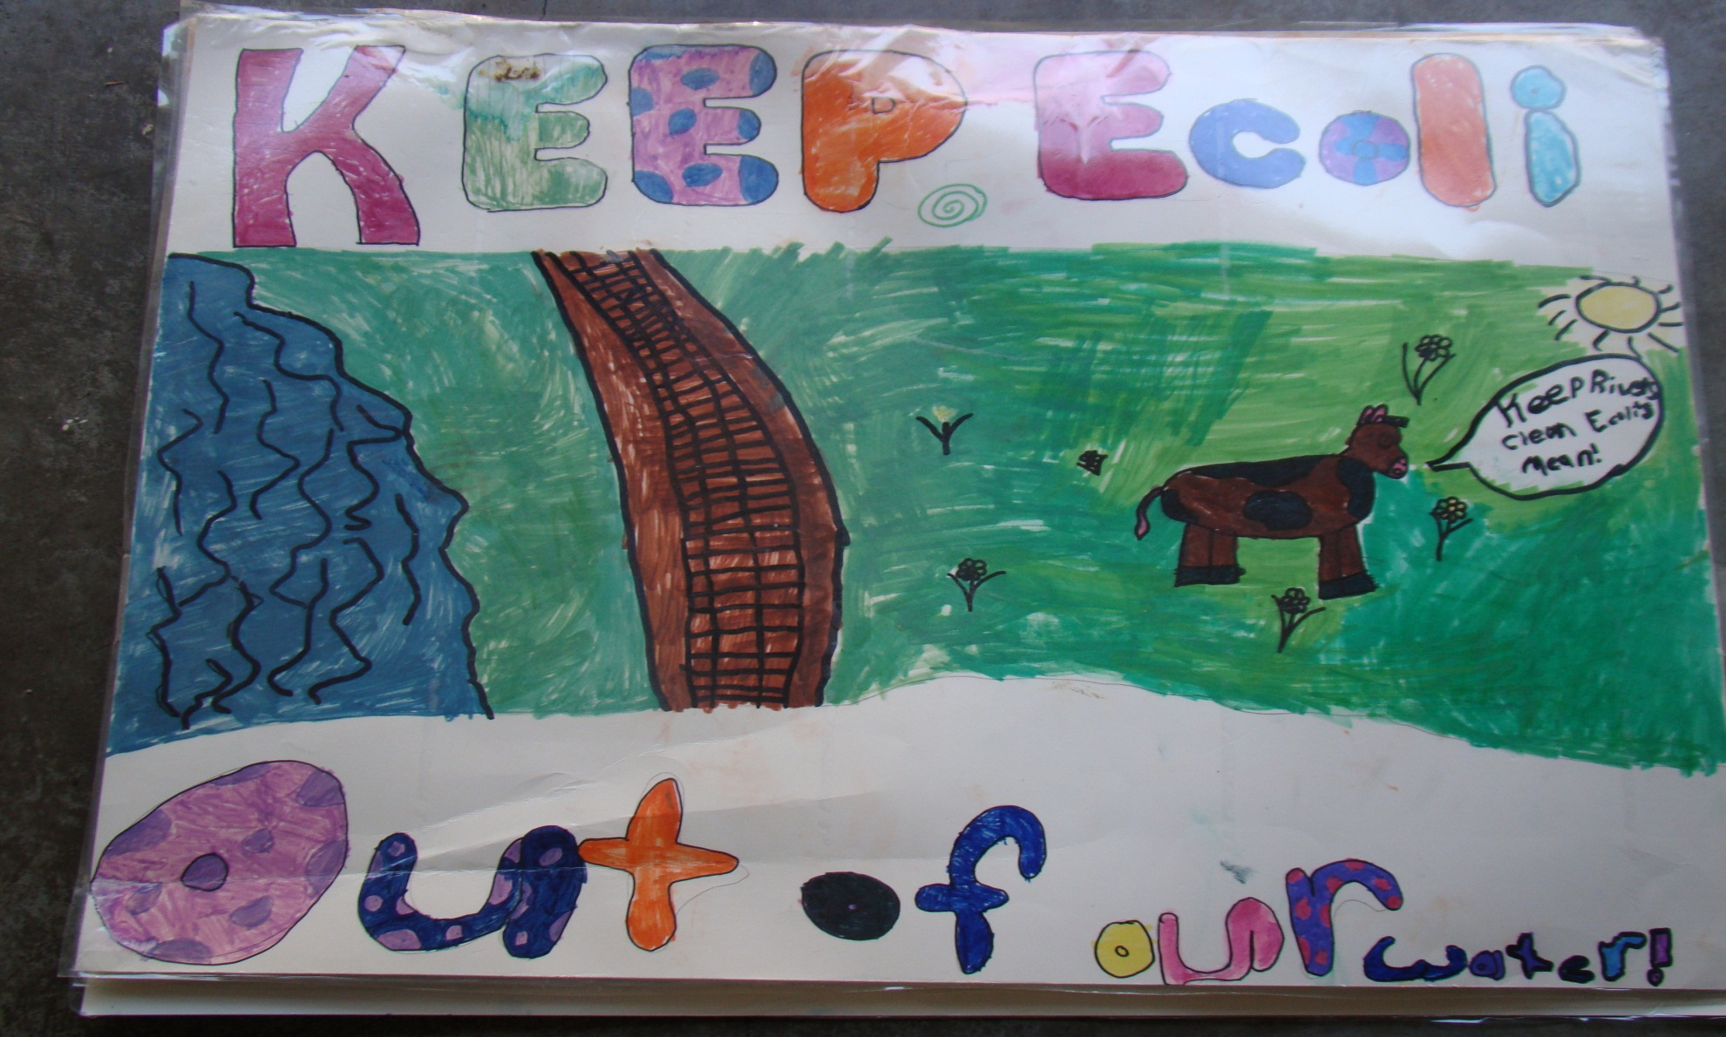
AWARENESS-RAISING ART
TO FIX THE PROBLEM

Slide 32
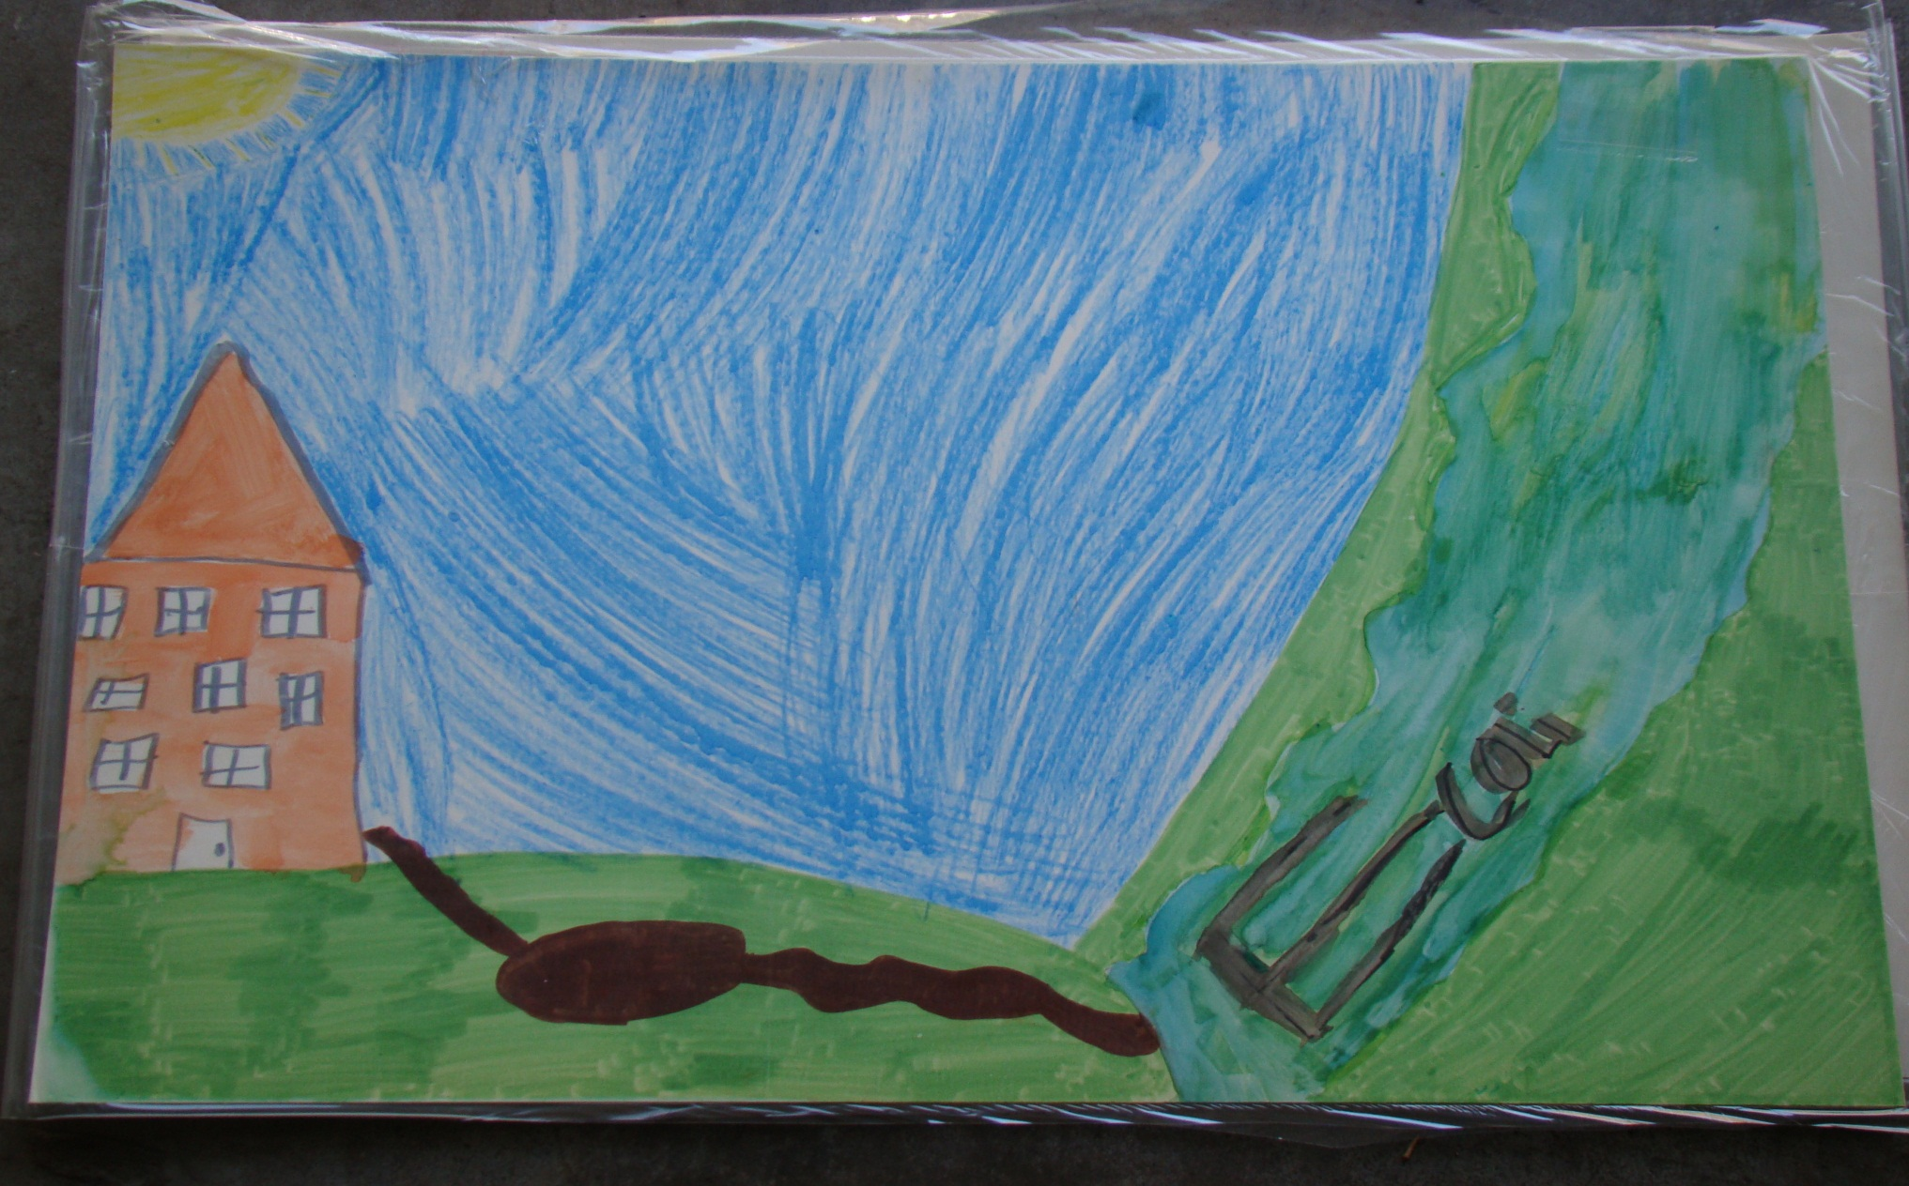

Slide 33
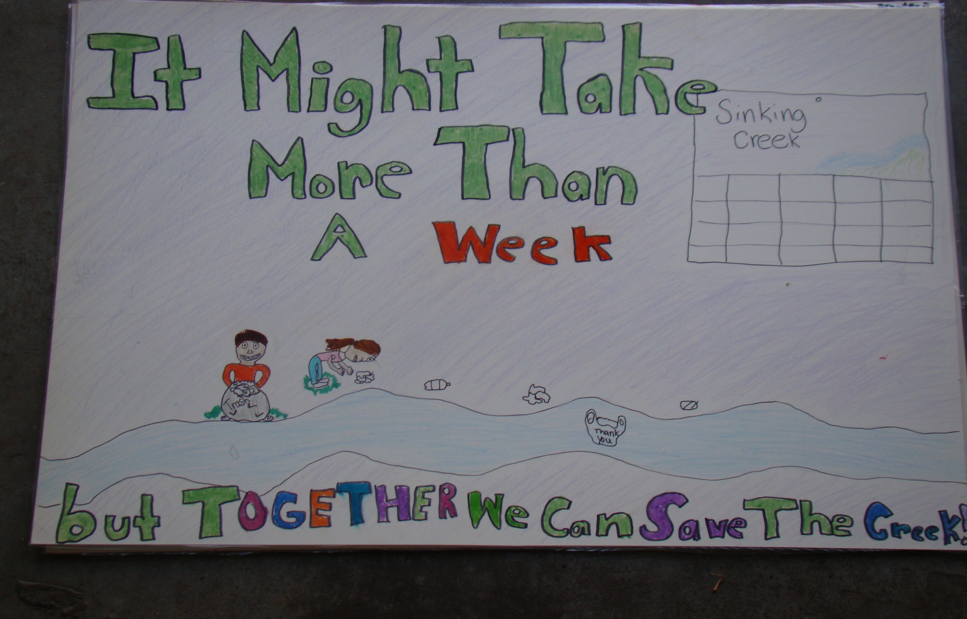

Slide 34
Sources
American Academy of Microbiology, “E. Coli: Good, Bad, & Deadly” 2011
Boone Watershed Partnership, www.boonewatershed.com
Bill Francisco
  http://www.facebook.com/jacobfrancisco.awareness
  http://www.jacobfrancisco.com
Partnership for Food Safety Education, http://www.fightbac.org
Google Image Sources:
  www.spcure.org
  www.home-water-filters-purifiers.com
  www.omafra.gov.on.ca
  www.nocafos.org
  septic-system.info
  www.pottyon.com
  ntnews.com.au

