Slide 1
Environmental Education Park at Sinking Creek

Slide 2
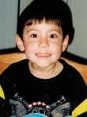
A Community Project Inspired by
A Six Year-Old Boy
Boone Watershed Partnership
City of Johnson City
East Tennessee State University
Corporate Partners
Individual Contributions

Slide 3
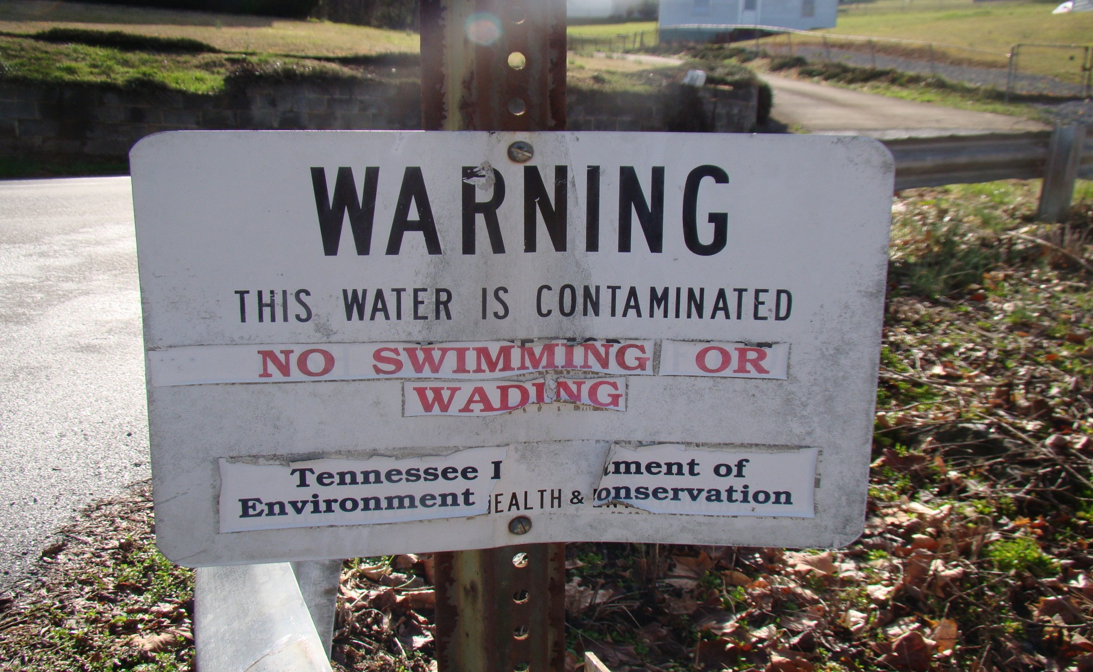
Sinking Creek Is Contaminated with Harmful E. coli Bacteria
It is on Tennessee’s 303(d) list of impaired streams
It is almost 10 miles long running through south Johnson City as a tributary to Watauga River in the Boone Watershed.
Boone Watershed is one of the most densely populated watersheds in the TVA system.
Certain parts of Sinking Creek are not safe for kids to explore or for families to irrigate their gardens.

Slide 4
An Unknown Source of E. Coli 0157:H7 Killed Six Year-Old Jacob Francisco
Three days before Father’s Day 2004, Jacob had a low-grade fever and lethargic, but the next day he was playing.
Saturday morning, he had abdominal cramps, diarrhea, and blood was discovered in his stool. His pediatrician suspected E. coli contamination, and sent him home with instructions to hydrate. There is no medicine.
His cramps continued through Father’s Day, but Monday the pediatrician said Jacob appeared more hydrated than Saturday.
The next day, Jacob was placed in PICU at Johnson City Medical Center. He died there seven days later.

Slide 5
Jacob’s Fame
A couple months before he got sick, Jacob declared that he would be famous one day.
When his mother asked for what would be his fame, Jacob couldn’t say.
He said he didn’t know for what he would be famous, but he said that he would be on the covers of magazines.
His family struggles to create Jacob’s fame for saving lives.

Slide 6
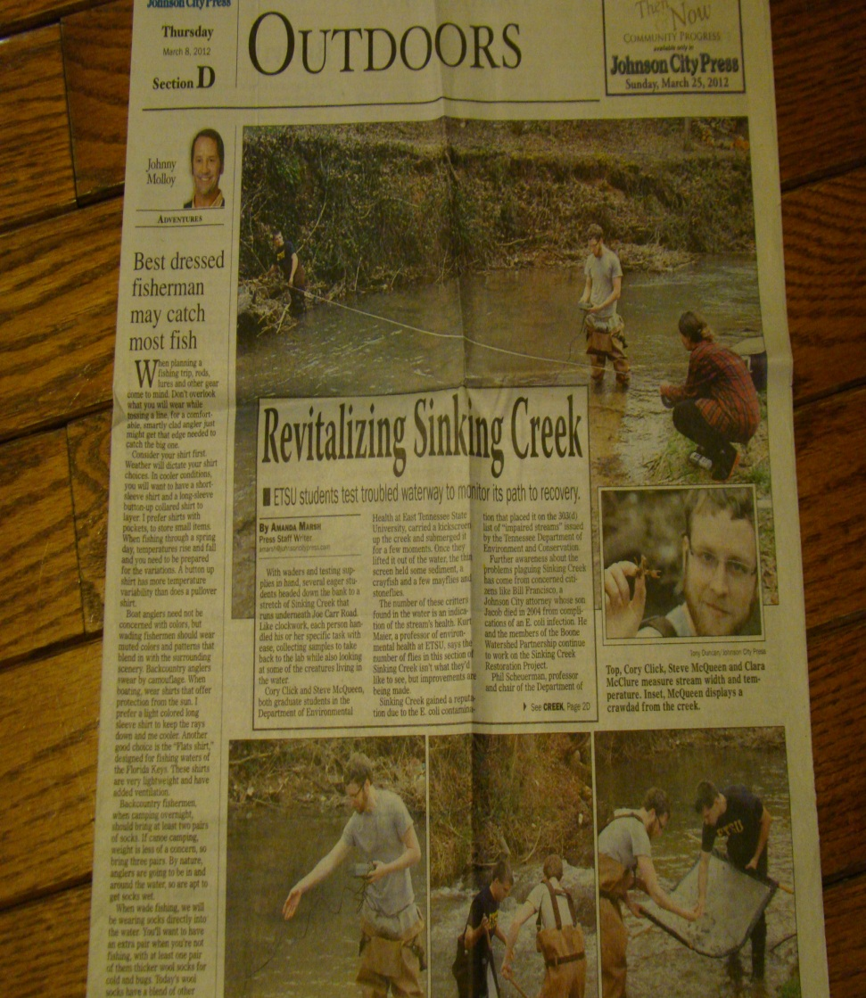
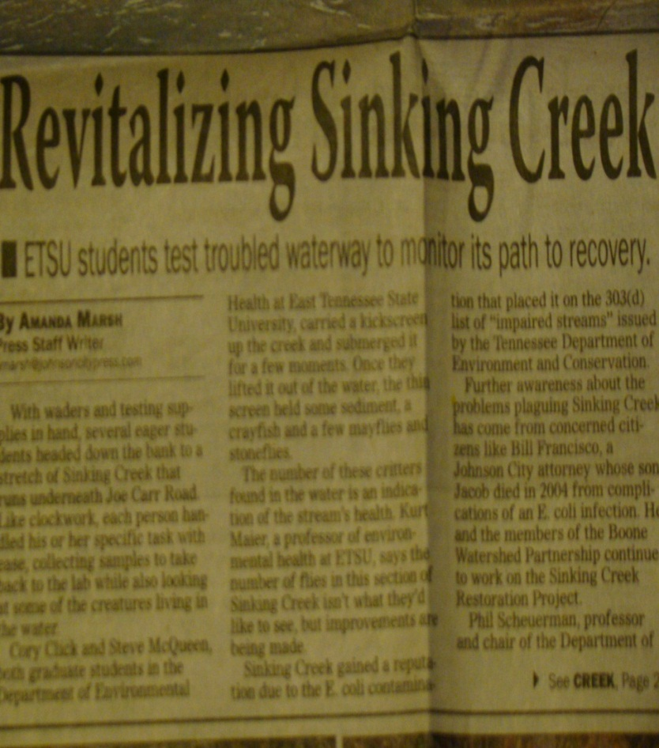
Envision A Park Where
Young Scientists Are Developed

Slide 7
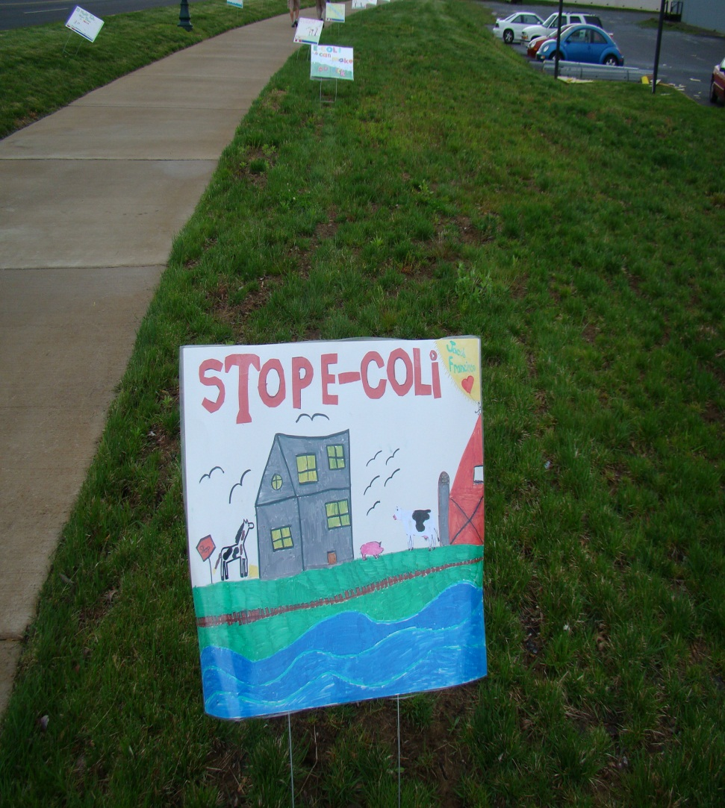
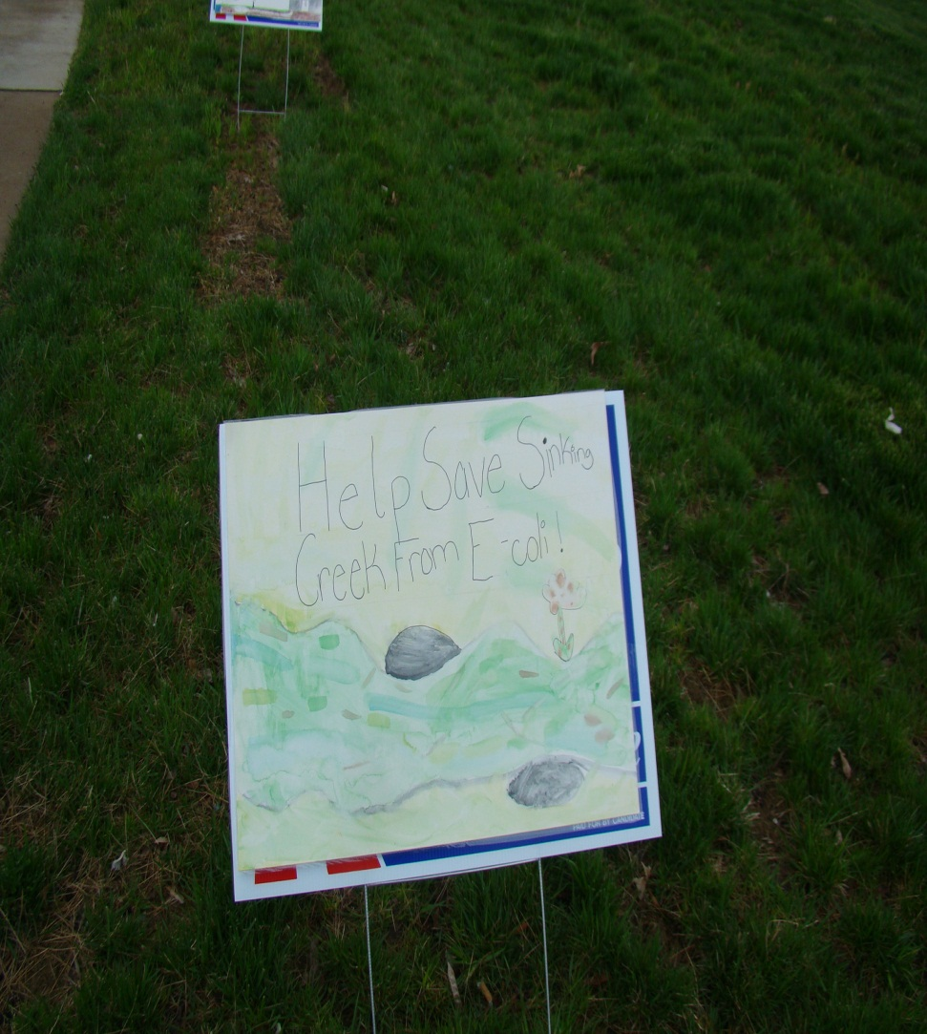
Students From Elementary through Post-Graduate Studies Will Learn

Slide 8
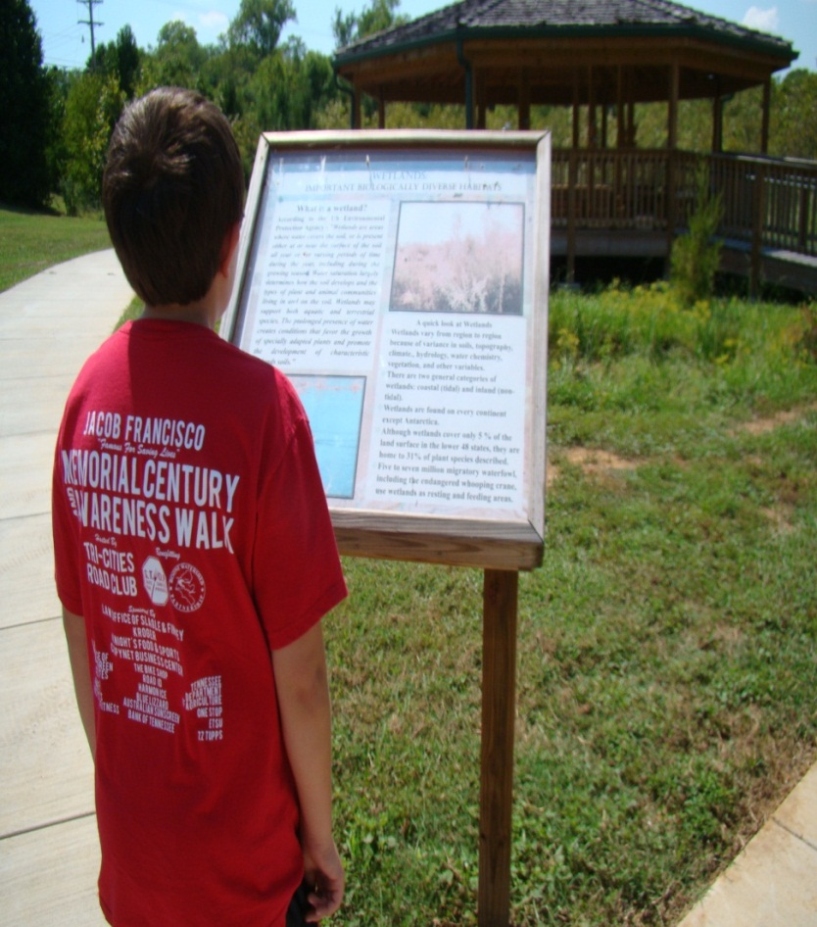
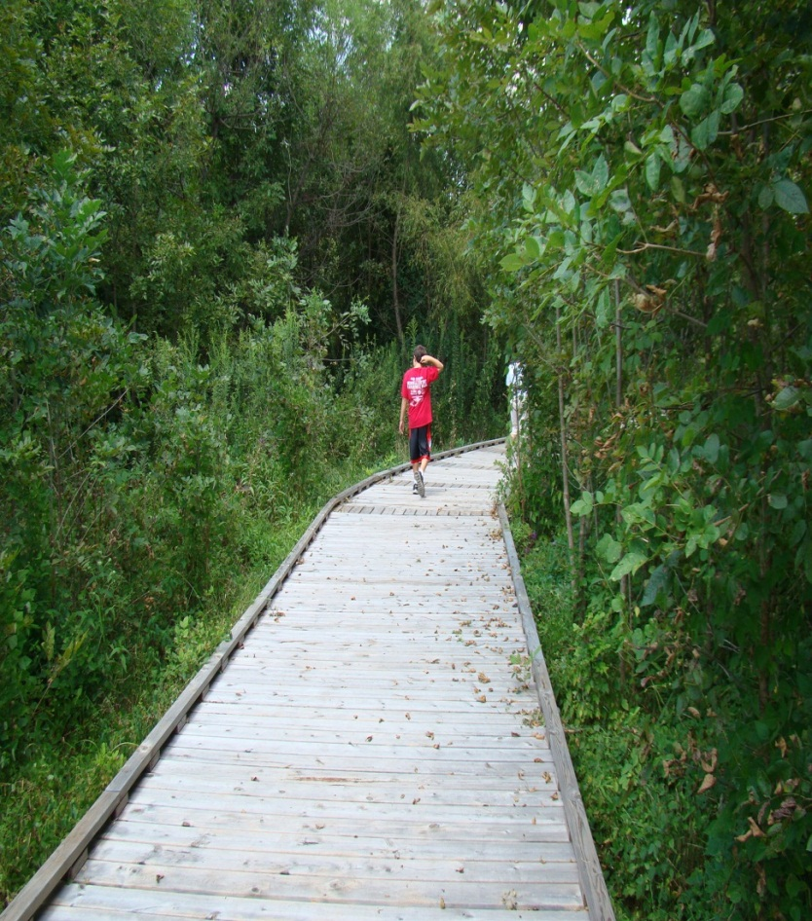
Outdoor Classroom, Interpretive Signs, Boardwalks and Trails Over Habitats Similar To Pistol Creek Wetlands

Slide 9
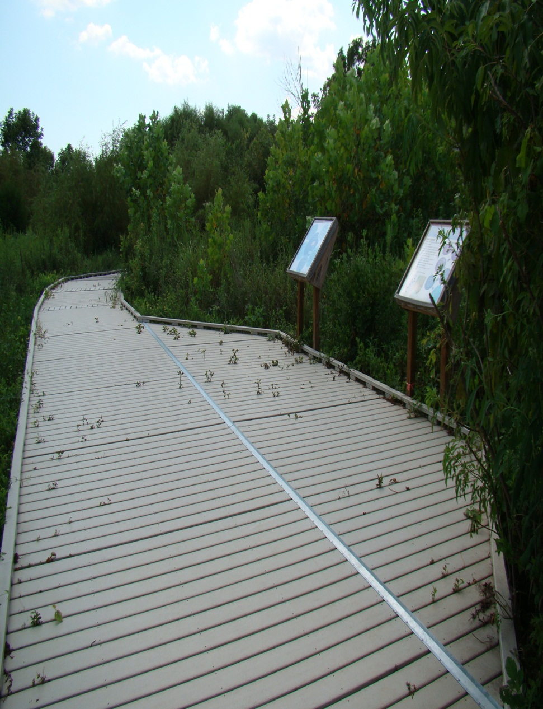
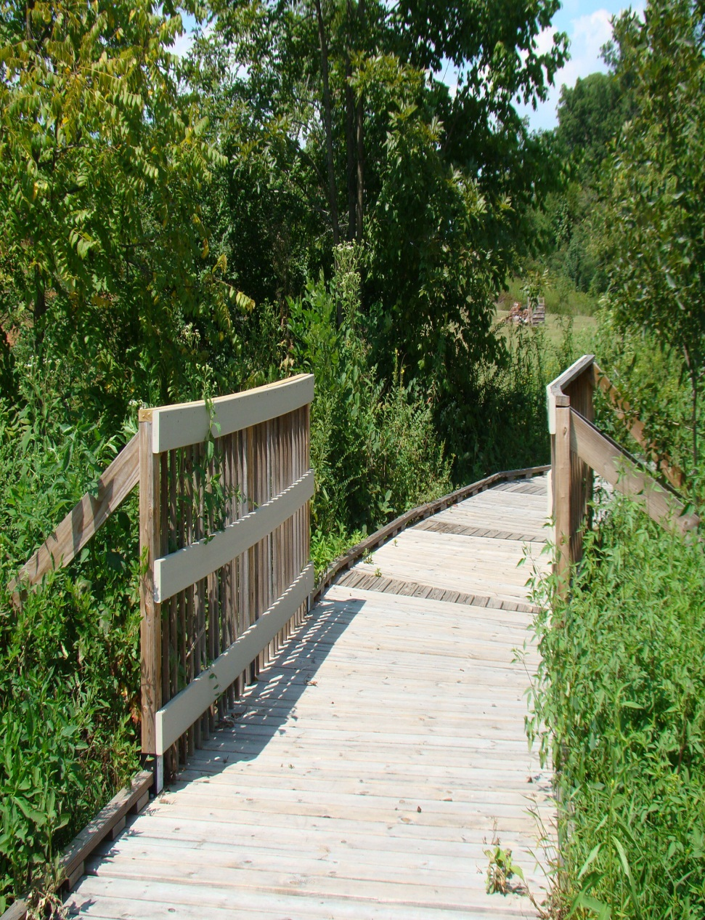

Slide 10
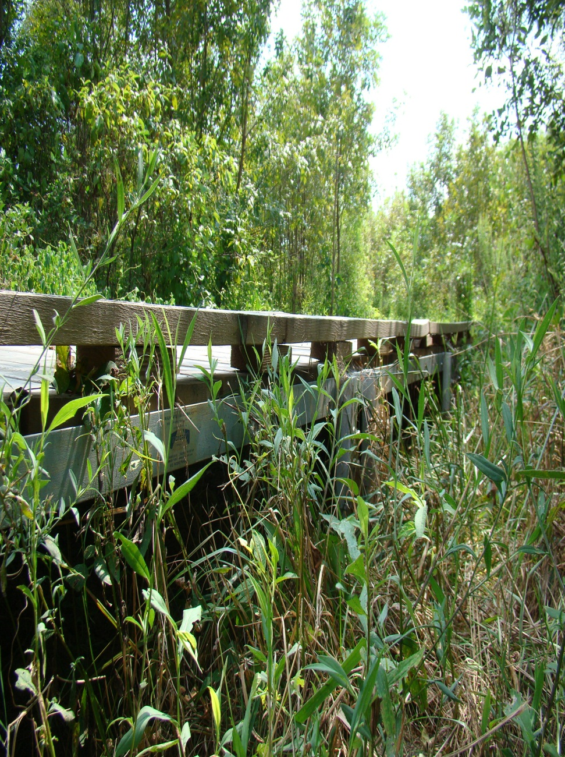
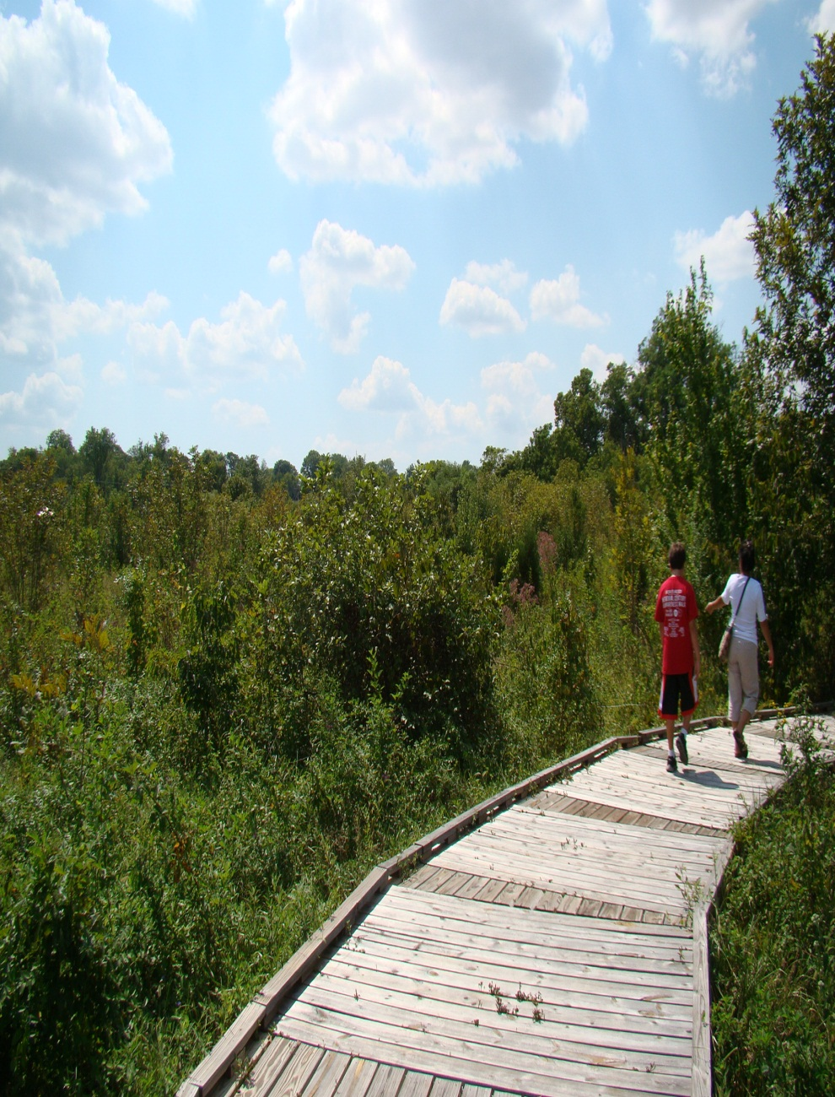

Slide 11
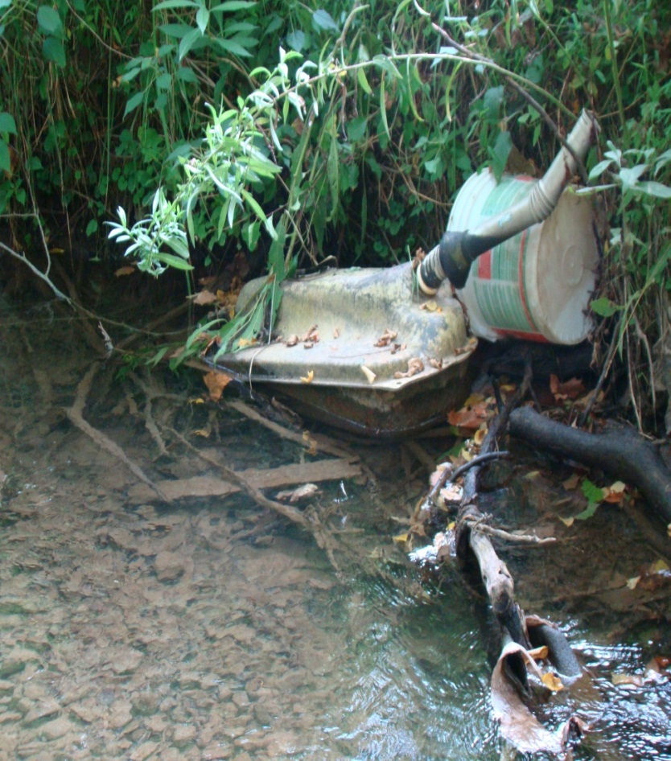
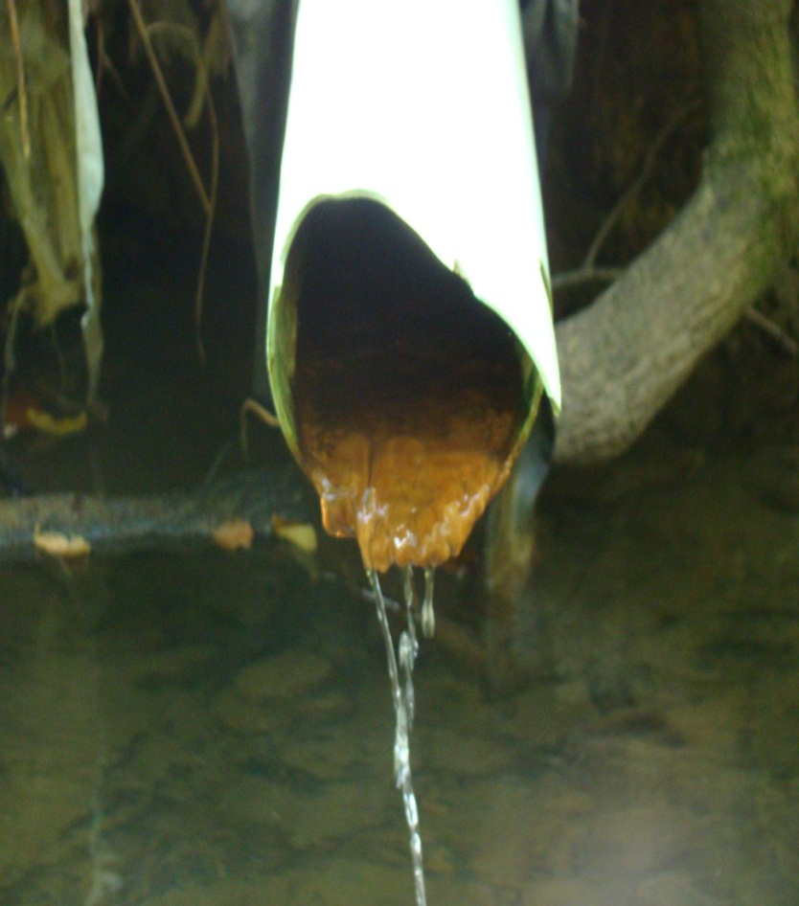
We Can Do Better Than This
With the 28 Acres at Sinking Creek in Johnson City

Slide 12
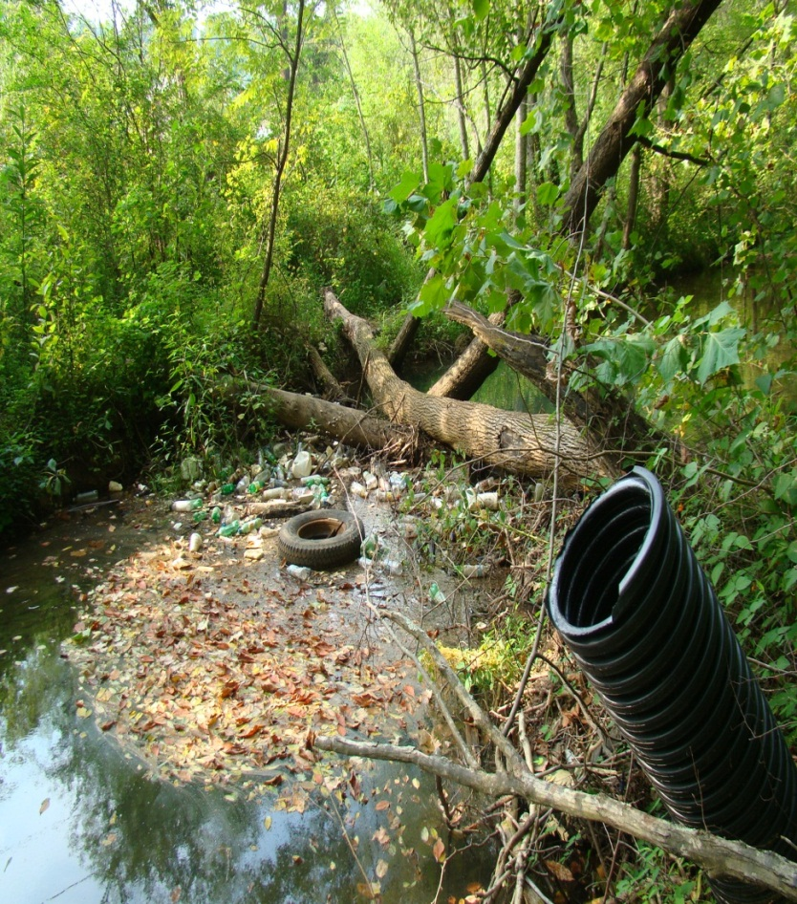
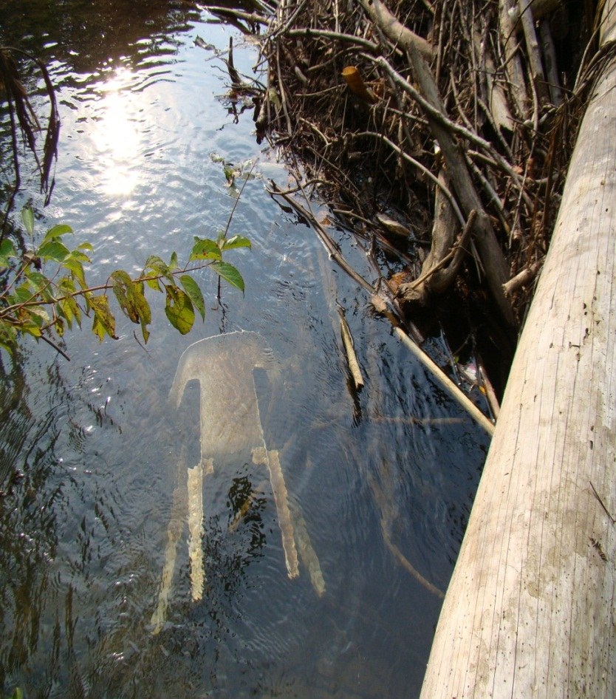

Slide 13
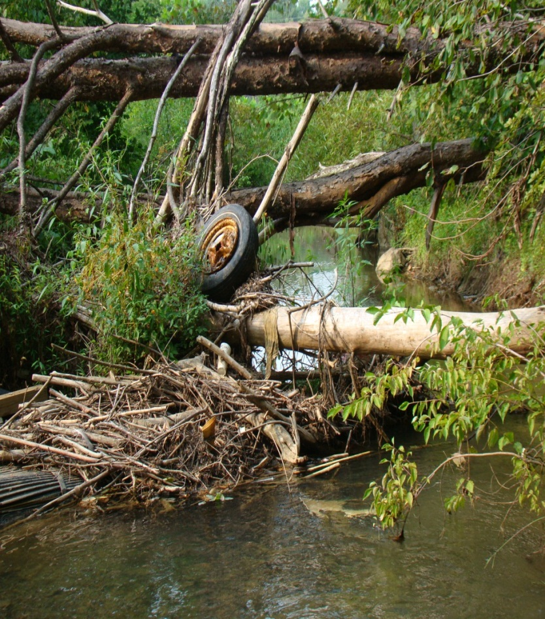
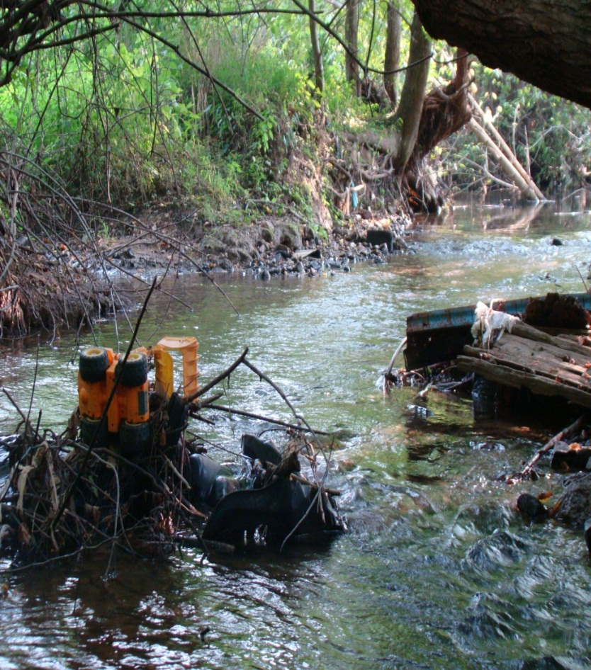

Slide 14
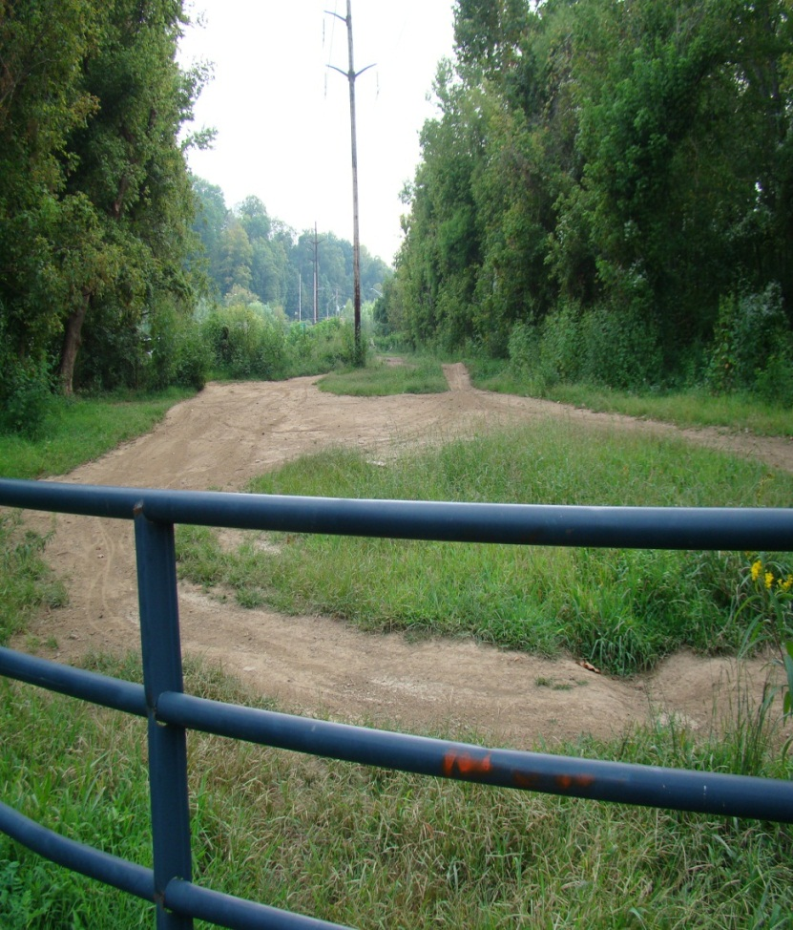
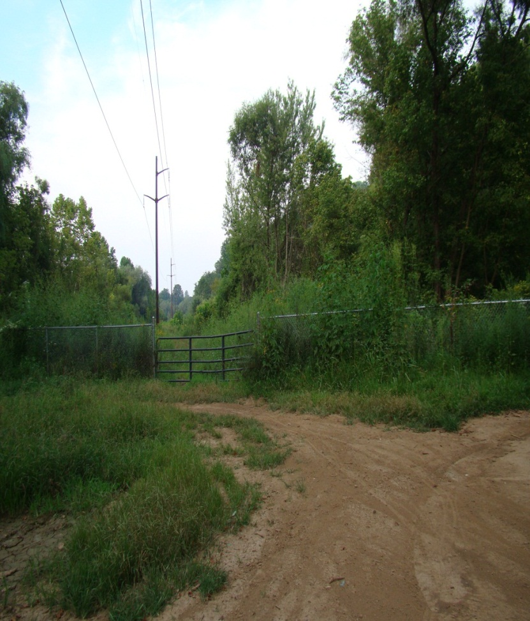

Slide 15
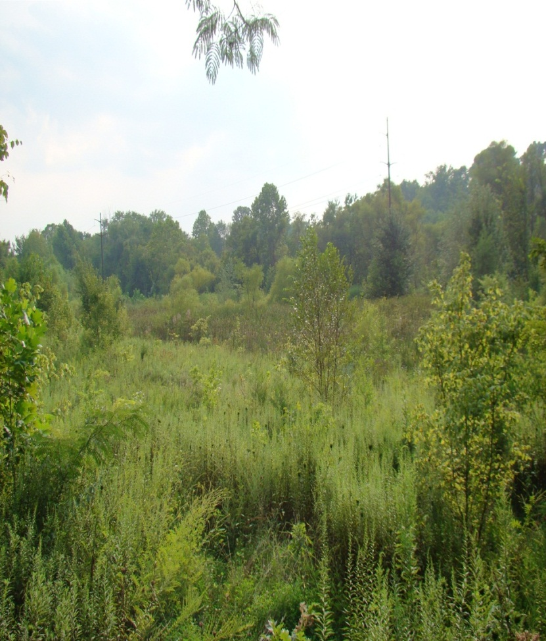
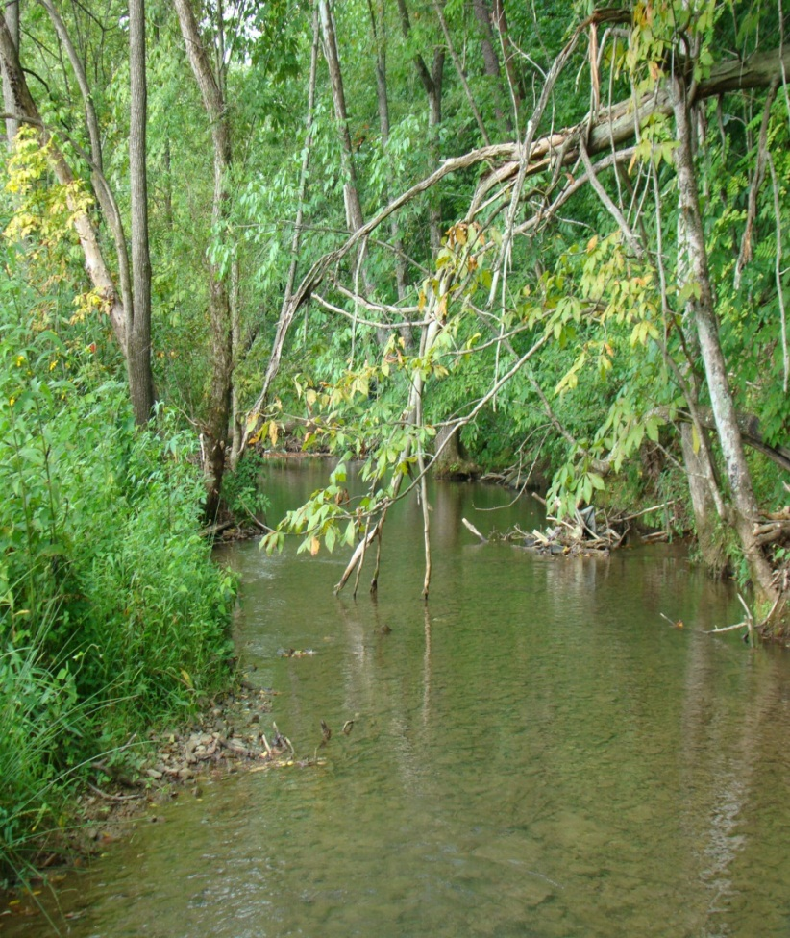
It Is A Beautiful 28 Acres That Deserves The Right Attention

Slide 16
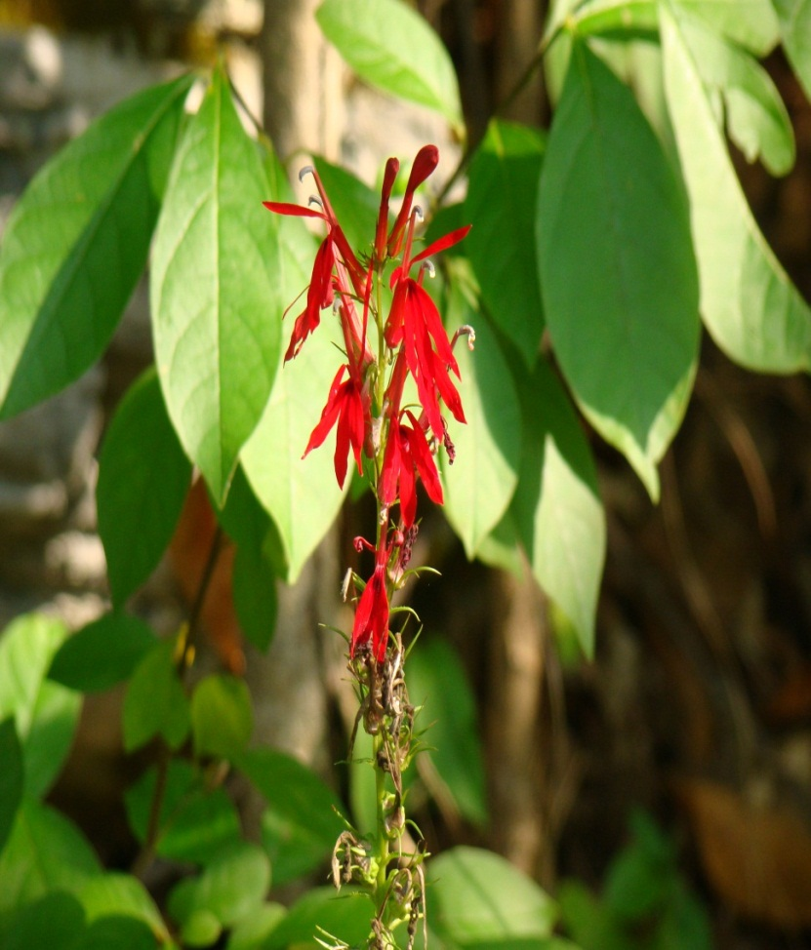
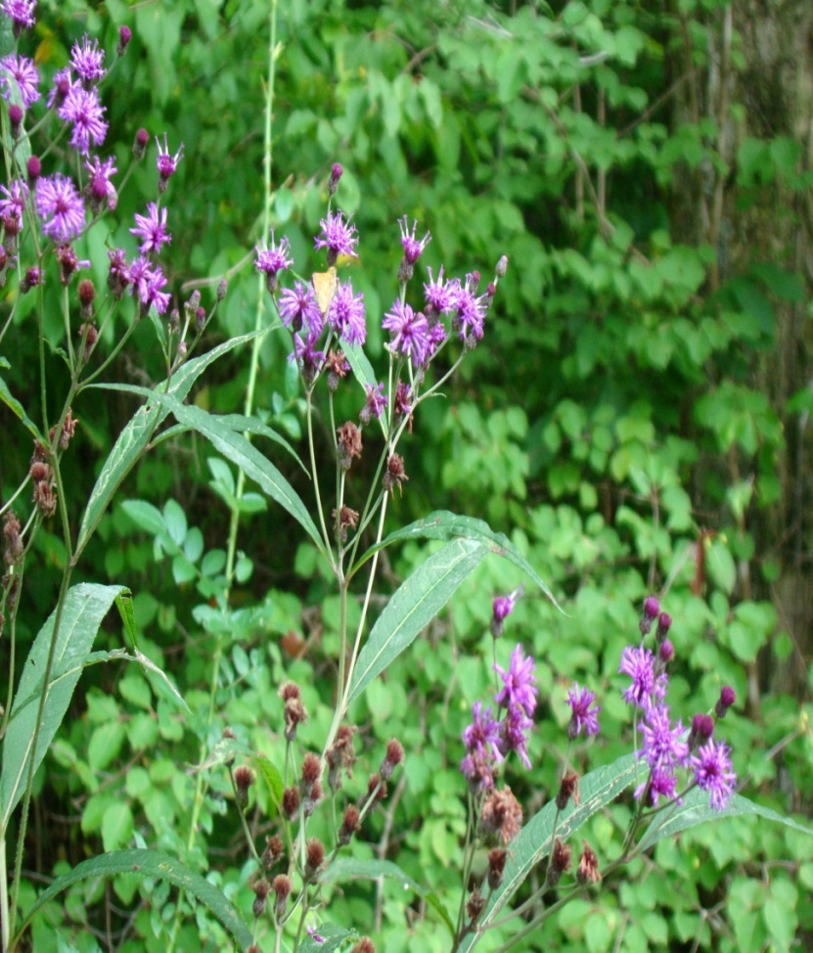

Slide 17
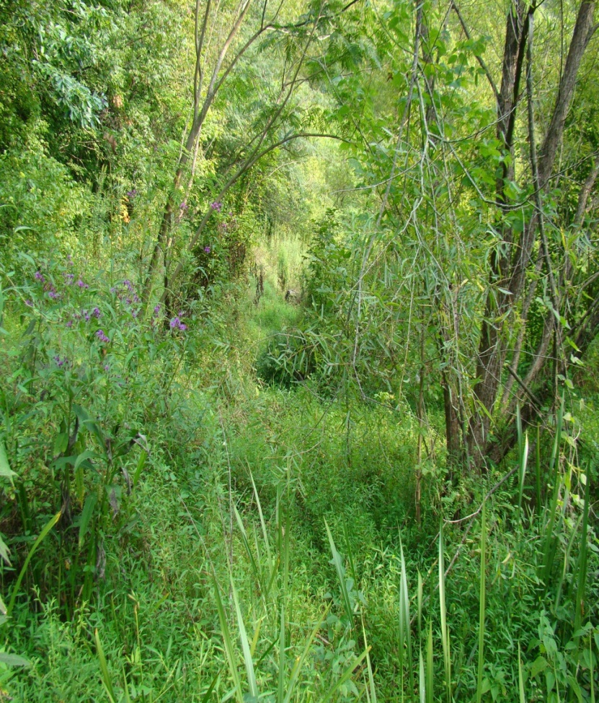
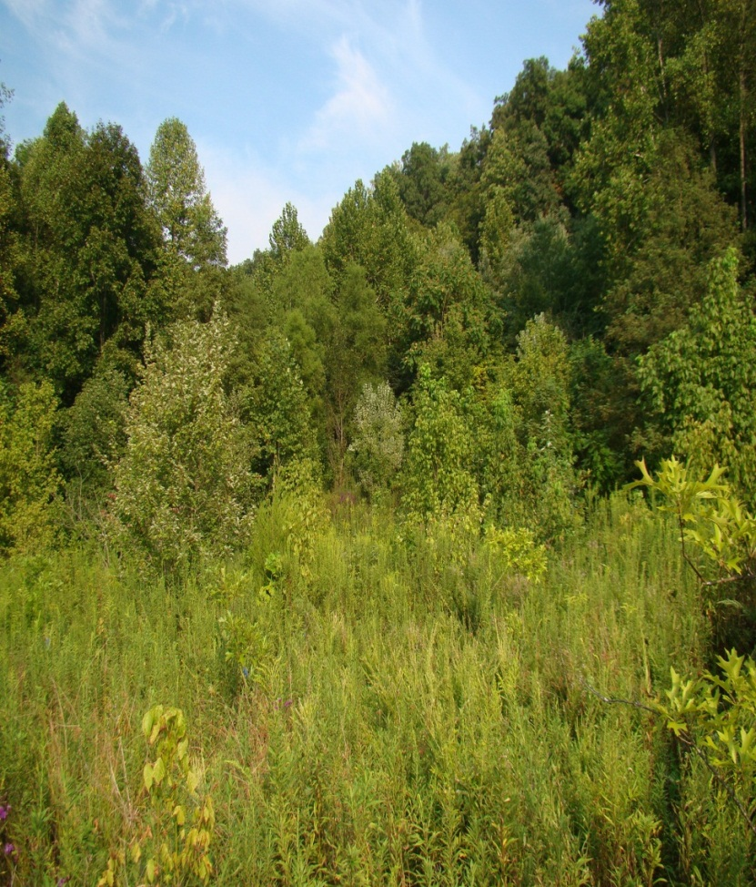

Slide 18
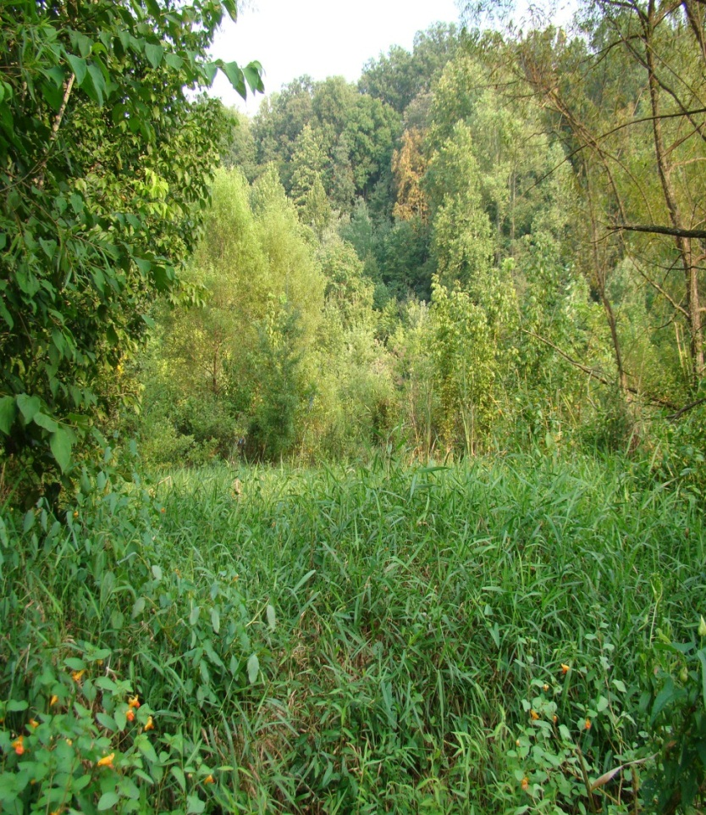
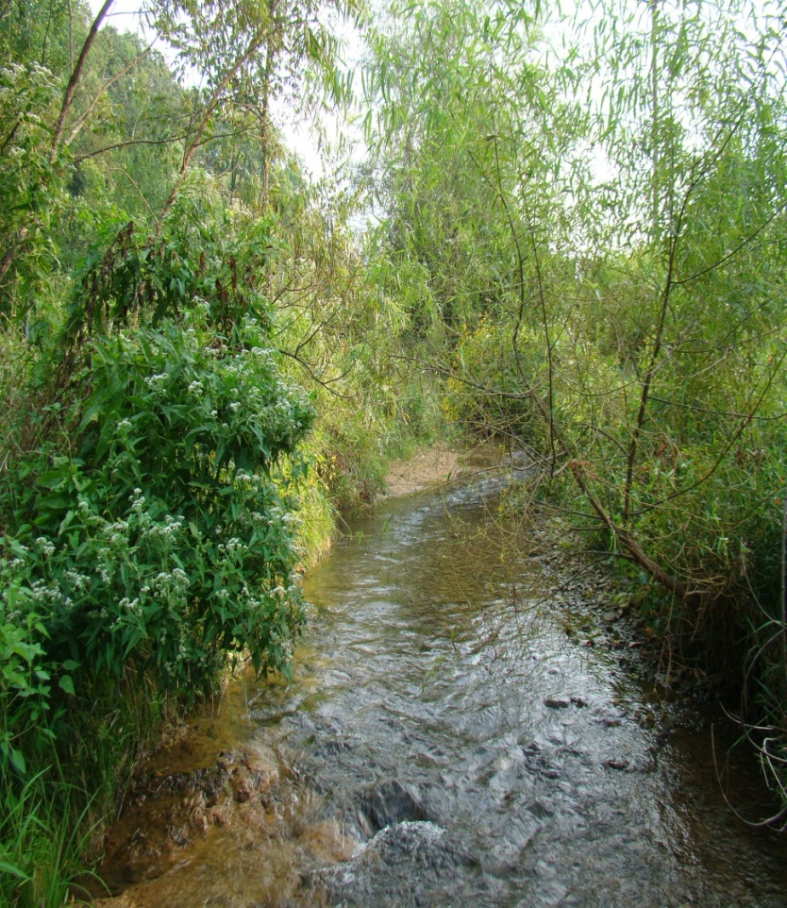

Slide 19
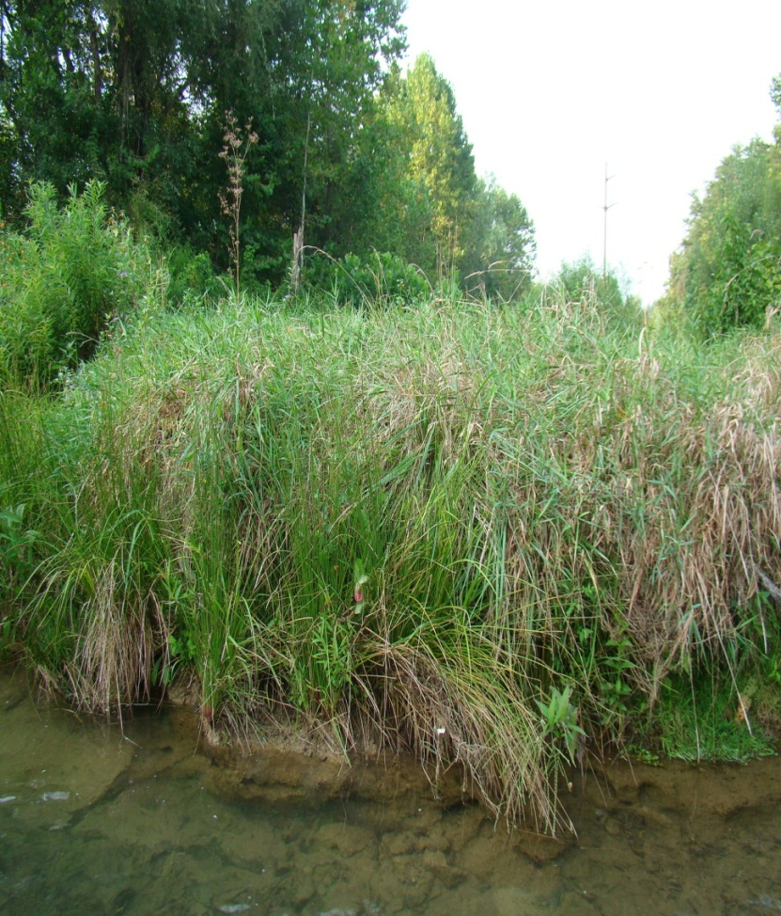
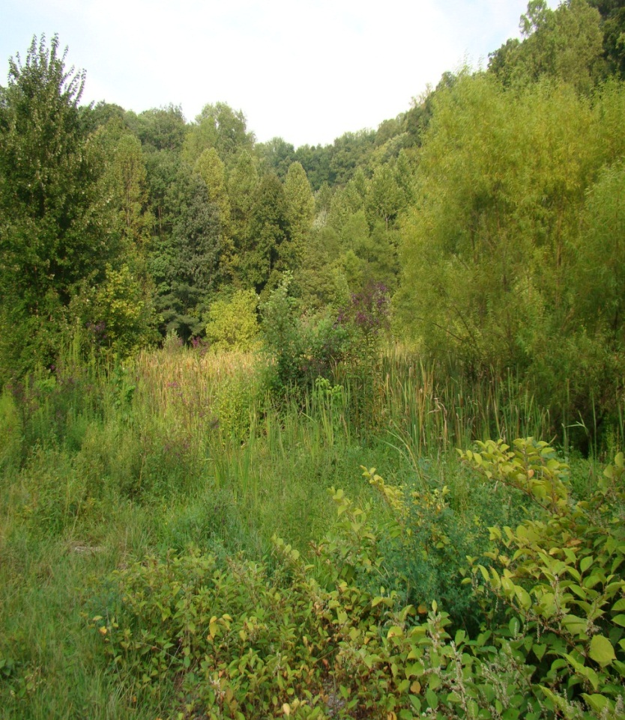

Slide 20
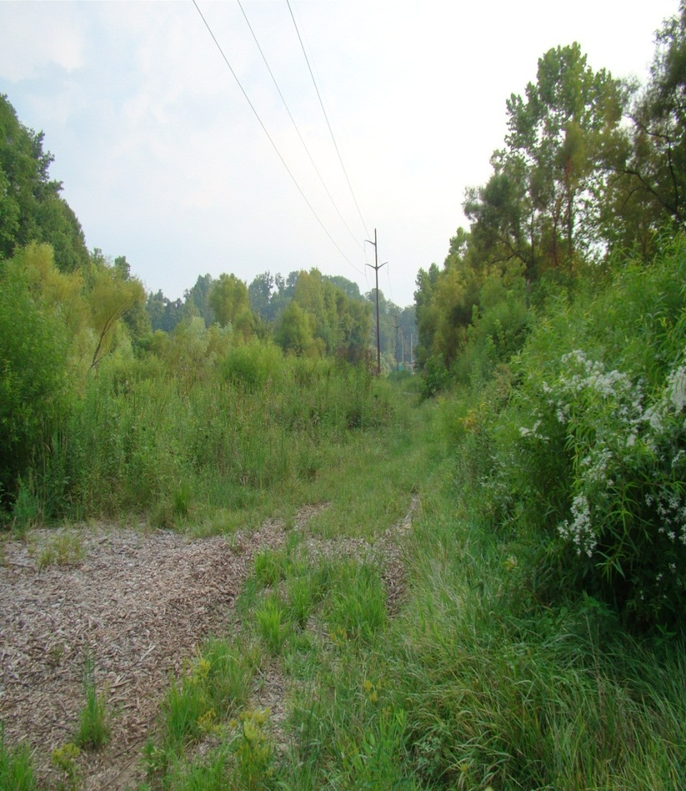
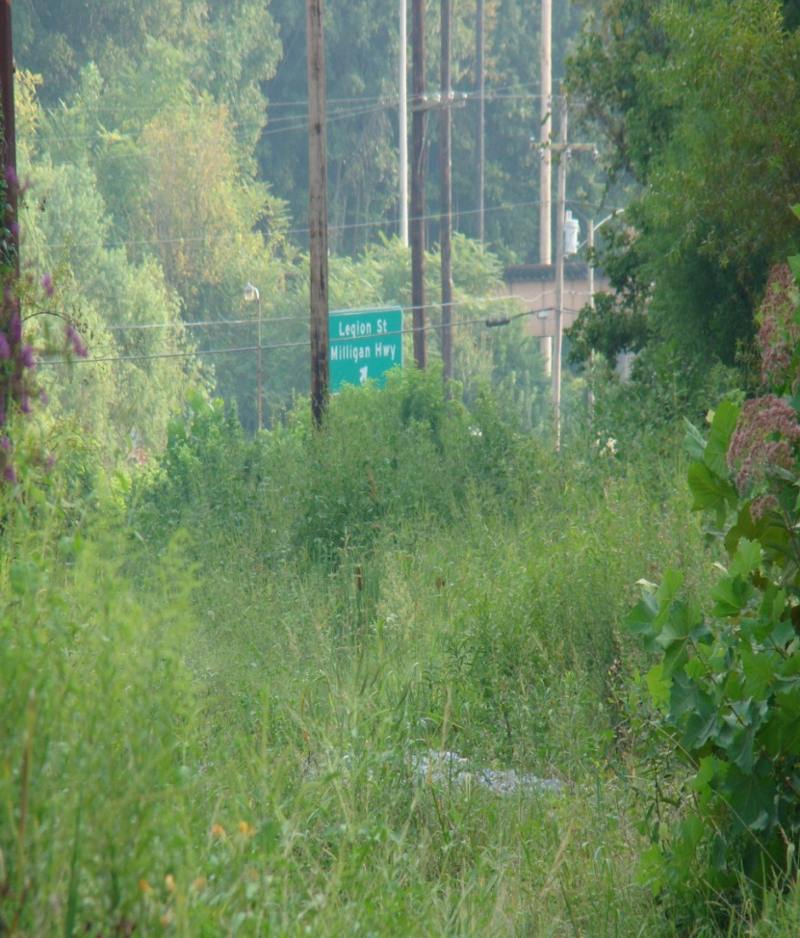

Slide 21
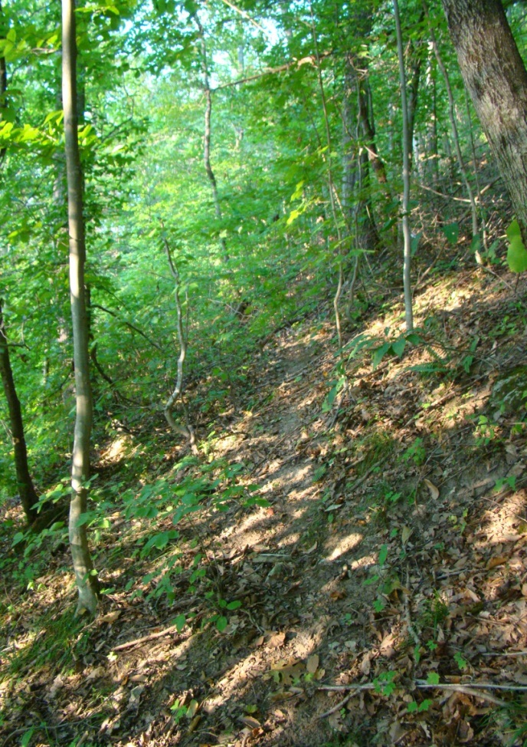
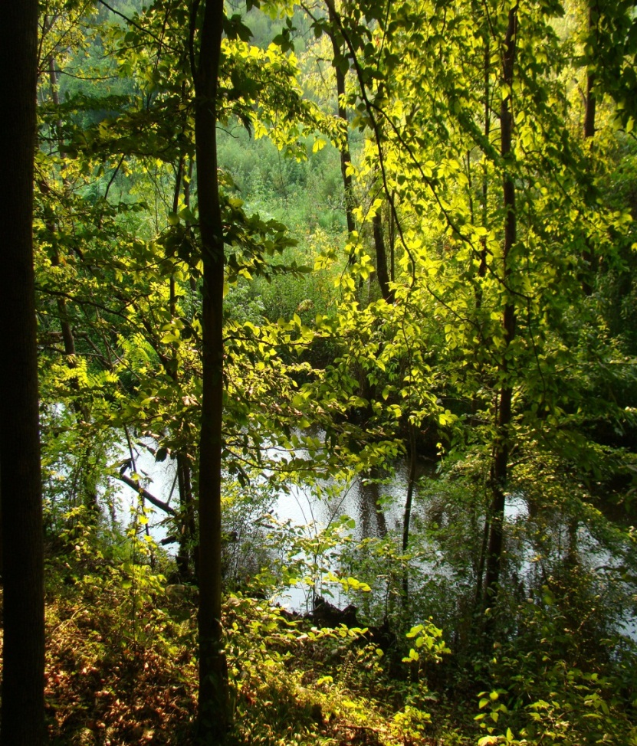

Slide 22
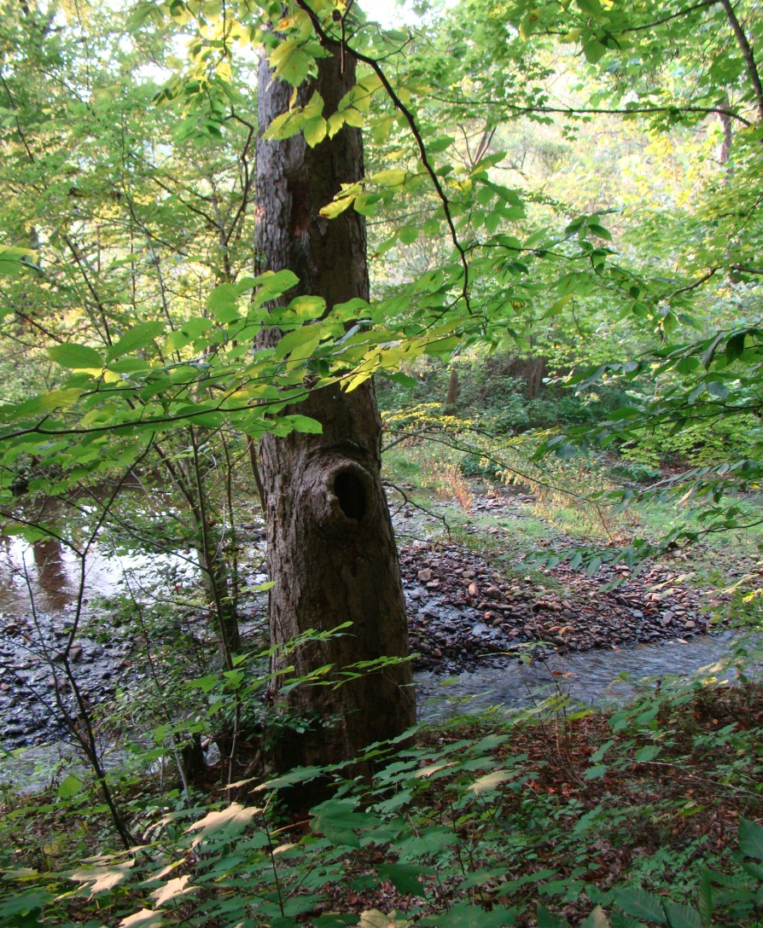
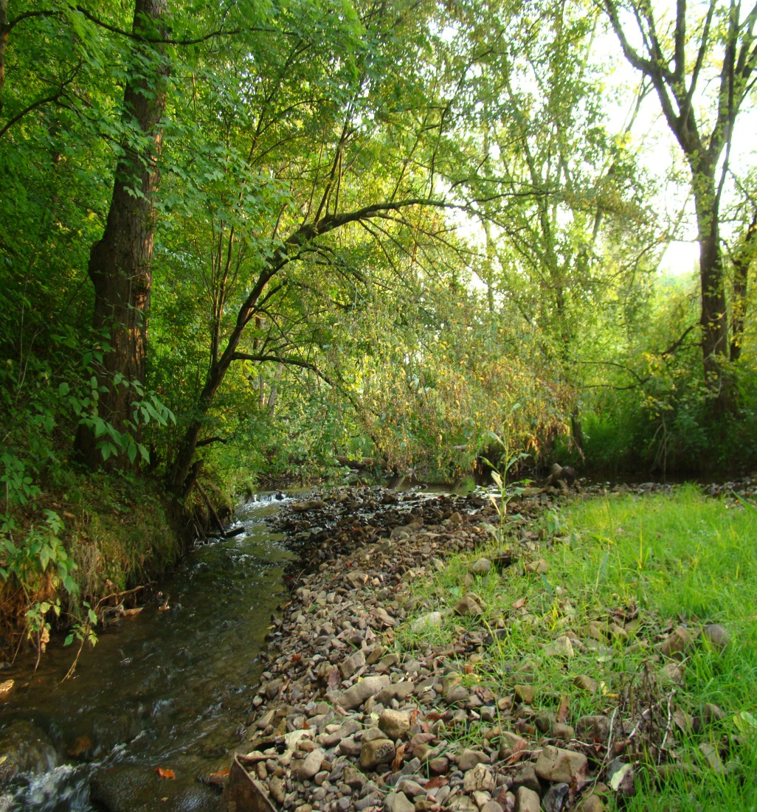

Slide 23
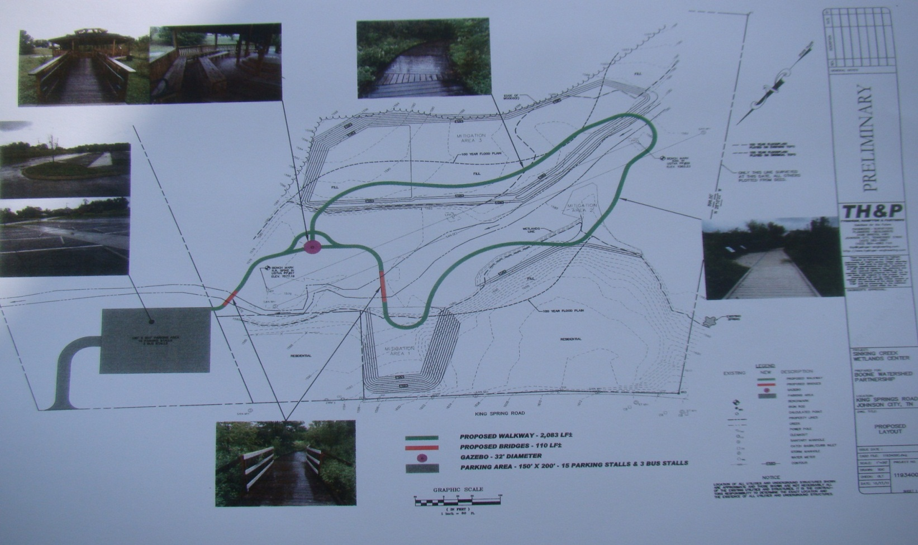
Preliminary Layout of Parking Lot, Outdoor Classroom, Boardwalk, and Bridges at Sinking Creek Wetlands

Slide 24
Items and Cost Estimates
Parking: 15 stalls & 3 bus stalls: $140,000
Gazebo: 32’ Diameter: $45,000
Boardwalk: 1900 LF – 8’ wide: $285,000
Signage: ?
ESTIMATED TOTAL: $500,000

Slide 25
Be A Part of Making Jacob
Famous for Saving Lives
“Mommy, I’m going to be famous one day,” said Jacob spontaneously. His mother asked, “Are you going to be a famous soccer player?” “No,” Jacob replied. She asked, “Are you going to be president of the United States?” “No,” Jacob replied, “I don’t know what I’ll be famous for, but I will be on the covers of magazines.”

Slide 26
Tax-Deductible Donations Welcome
Make Contribution Payable to:
BWP-Sinking Creek Park
Send Contribution to: c/o Matt Dake, Treasurer,
578 Beaver Creek Road, Bluff City, TN 37618

Slide 27
More Information
www.jacobfrancisco.com
www.boonewatershed.com
Bill Francisco: wlcisco@aol.com

